Slide 1
Ethical Challenges of Social Media and Virtual Counseling
Kathryn Coleman, MSW, LCSW, CAADC
Corporate Clinical Trainer
Pyramid Healthcare, Inc.

Slide 2
Session Description
With increasing capabilities in technology and electronic communication, behavioral health services face new challenges and ethical problems. In this session, participants will develop an understanding of the crucial relationship between technology and ethics and examine factors contributing to ethical dilemmas including e-mail, social media, telemental health and distance counseling. Participants will apply strategies and guidelines to mitigate increased ethical vulnerabilities in the virtual world.

Slide 3
Session Objectives
1. Identify the concepts of social media, virtual counseling and
telemental health and describe at least four challenges facing
behavioral health practitioners related to increased capabilities
in technology and electronic communication.
2. Learn strategies and guidelines that build wider competencies to
mitigate ethical vulnerabilities in the virtual world.
3. Analyze and apply at least four strategies that will contribute to
dealing effectively with ethical dilemmas in virtual communication.

Slide 4

Distance (Virtual) Counseling
Distance (Virtual) counseling: the delivery of psychological
services using electronic tools for maximum effectiveness in
technology- assisted therapy
Providing counseling/therapy services
remotely via telephone, e-mail, texting or
video-conferencing

Slide 5

Social Media
Social Media – technology-based forms of electronic
communications through which users create online personal
and professional virtual communities to share information,
ideas, beliefs, personal messages and other content , e.g. :
  Twitter, Google+, Yahoo
  Linked In, List Serves,
  E-mail, Texting, Mobile-Based Apps
  Chat rooms, Instagrams
  Blogs, Facebook, My Space

Slide 6
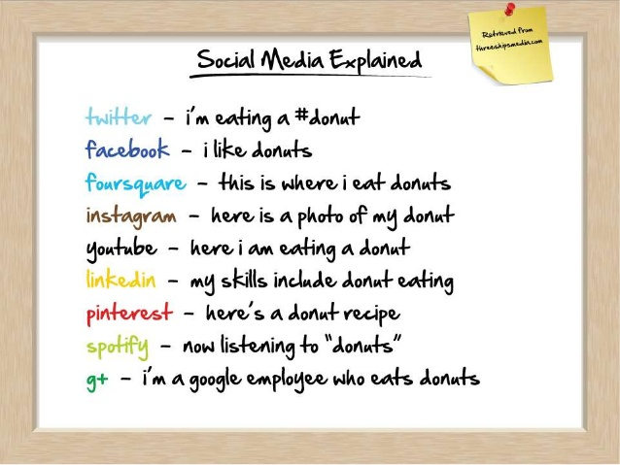
Social Media

Slide 7

c
1970’s – telehealth first used by hospitals to provide
MD to MD consultation
2000 - Independent clinical and health practitioners began to use this methodology for therapy
21st century – the increased use of communication
by text, instant messages, email, etc.
2006 – telehealth and face to face counseling given same rate compensation in some states by law
2010 - State certification for e-therapy by Florida

Slide 8

Benefits/Advantages
Accessibility
Adaptability
Affordability
Convenience

Slide 9

Accessibility
Rural/Frontier/Remote areas
Areas with mental health professional shortages
Underserved populations
Disability, illness, mobility and homebound concerns
Special MH populations including debilitating or isolating
SUD/MH concerns
Quick appointment availability
Extension of pre-established relationships when client relocates or is mobile
Access to specialists and consultants on particular problems

Slide 10

Adaptability
Available for concerns about anonymity, stigma and shame
Multiple ways for self expression
Beneficial for individuals who do not wish face-to- face
counseling
Adjunct to sessions for client support and follow-up care
for both virtual and traditional therapy
Counseling opportunities for those familiar and
comfortable with technology

Slide 11

Affordability
Lower cost to consumer
Lower cost to clinician due to lower overhead
May not require large investment in
equipment for client or counselor
Decreased travel time and expenses
Third party payor compensation

Slide 12

Convenience
Transportation problems
Child/Elder care issues
Time constraint concerns
Travelers
Wider range of business hours and available appointments
Can be done in home if appropriate
Clients can be in their comfort zone for counseling

Slide 13

Limitations/Disadvantages
Confidentiality/Security of Data and
  Client Information
Technical Difficulties
Limits to Populations Served
Therapist Credibility
Therapeutic Hurdles
Jurisdictional/Legal/Risk Management Concerns

Slide 14

Confidentiality/ Security and of Data and Client Information
Protection of confidential information
Transmission, storage and disposal of data
Utilization of way to protect sensitive communication
Written consent prior to establishing e-relationship
Note taking, record keeping and documentation
Administrative emails and texts

Slide 15

Technical Difficulties
Technical “know-how” required to set up and
operate e-communication effectively
Intercepted transmission
Lost connections/lag time/audio & video blips
Risk of spyware
Troubleshooting technical problems on client site
Choosing appropriate operating systems for client and
counselor

Slide 16

Limits to Populations Served
Some people require face to face counseling
Some therapy approaches not amenable to
virtual methods, e.g. expressive arts therapies,
EMDR, play therapy, animal-assisted therapy
Homicidal/Suicidal situations
Some diagnoses less appropriate for e-therapy

Slide 17

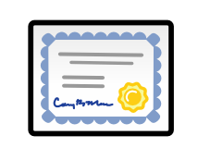
Therapist Credibility/Client Identification
Poorly regulated
Unqualified people getting involved
HIPPA and HITECH violations contributing
to e-therapy appearing less professional
        Verifying identity of therapist and client at each session

Slide 18

Therapeutic Hurdles
Challenges to developing and maintaining
the therapeutic relationship
Lack of verbal/non-verbal cues and
information in non-visual communication
Ambiguity/ potential misunderstanding
that can be present in electronic communication
due to lack of visual/auditory cues

Slide 19
Therapeutic Hurdles
Assessment/Screening- related difficulties
Handling emergency/crisis situations
Hand-offs and referrals
Managing informed consent
Monitoring physical symptoms, emotional
decompensation

Slide 20

Potential Ethical Problems
Lack of Ethical Guidance
Boundary Issues/Dual Relationships
Informed Consent/Autonomy
Competency
Jurisdictional issues
Confidentiality/Privacy
Maintaining Clinical Standards
Appropriate Therapeutic Interventions

Slide 21

Lack of Ethical Guidance
Provision of ongoing supervision
Knowledge of updated information about technical and ethical standards related to social media and virtual counseling
Lack of literature and research to provide guidance

Slide 22

Boundaries/ Dual Relationships
Separate personal and professional life in the digital
world to avoid blurring of the professional boundary
Awareness of accessibility to information
placed on social media that can interfere
with the client/counselor relationship
Be aware clients will research you; you
cannot research them without permission

Slide 23
Boundaries/Dual Relationships
Avoid solicitation of client testimonials
Clarify understanding with client regarding
how communication will be handled and
any limitations therein.
Set clear boundaries about when and where
clients can contact you

Slide 24

Boundaries/Dual Relationships
Be certain that anything you post on line
is something you would be comfortable
with your client, colleague or employer
seeing because it can be found.
Counselor self disclosure can be
unintentional by virtue of the availability
of information available through
digital sources

Slide 25
Boundaries/Dual Relationships
Cyberstalking is possible
It is unwise to “friend” clients
or former clients on your personal
Facebook and Linked In pages
Carefully use the privacy features
available to limit access to your posts

Slide 26

Informed Consent/Autonomy
Method to get written consent prior to e-therapy beginning
Concerns regarding treating minors
and consent issues
Providing information about the
pros and cons of e-therapy and
what is involved in the process
to allow client to make choice about
engaging in e-therapy

Slide 27
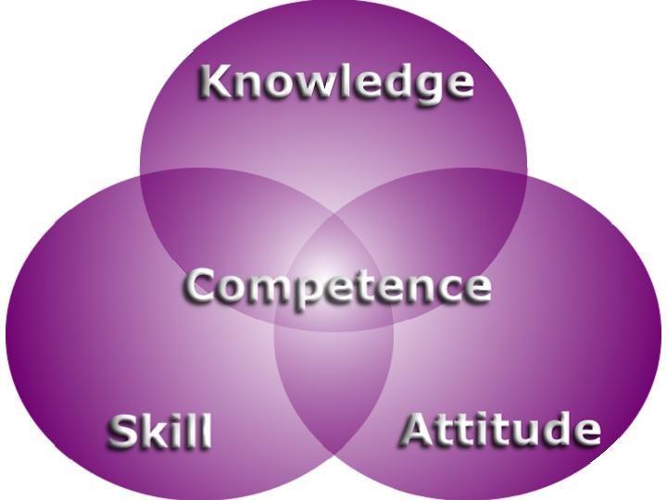
Competency
Sufficient education, training and
demonstrated skills in distance counseling
Continuing education to stay state of the
art in technology and interventions
Adequate ongoing supervision

Slide 28
Competency
Knowledge of the language and norms
of the virtual world
Understanding of the impact of e-therapy
on the client
Awareness of disinhibition factors in e-therapy

Slide 29

Jurisdictional Issues
Be informed about and apply legal, statutory and regulatory practices related to:
  Informed consent,
  Jurisdiction in out of state practice
  Local requirements for documentation
  Licensure requirements,
  Third party protocols,
  State laws regarding duty to warn and reporting child/elder abuse and,
  Requirements of confidentiality relevant to client information.
Authentication of client and therapist

Slide 30

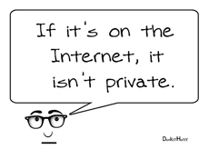
Confidentiality/Privacy
Limits of confidentiality; awareness of hacking, data
compromise, access to information etc. Nothing
that enters cyberspace is ever completely secure.
Assisting clients in maintaining security in their own system and their communications
Use of appropriate software, programs and
procedures to insure security and
confidentiality of information

Slide 31

Confidentiality/Privacy
Precautions to protect client privacy rights
with records stored and transmitted by
electronic means
Discussions with client regarding
confidentiality concerns and training
them about what they can do to
safeguard their information and
communication

Slide 32

Maintaining Client Standards
        - Reflecting the clinical standards of
        traditional face to face counseling in the
        new venue
        Fair, reasonable and customary fees for
        services with regard to client ability to pay;
        fee structure/billing discussed prior to
        entry into treatment

Slide 33
Maintaining Client Standards
Preparation of client for participation in
e-therapy either before or in initial session
Licensure and training to insure
consumer protection
Proper planning for power outages or
interruption in course of session

Slide 34

Maintaining Client Standards
Planning for crisis intervention and
handling emergencies, referral and
continuing care arrangements following
discharge
Continual re-evaluation of clinical status to
determine if modality of services is appropriate,
efficacious and safe
Prior research for effectiveness of chosen modality

Slide 35

Appropriate Therapeutic Interventions
Sensitivity to time zone differences, local client customs,
customs, cultural and language differences
        Thorough screening, intake and assessment
        processes to assure client appropriateness
        for e-therapy
        Case management including referral to more
        traditional counseling if clinically indicated and
        appropriate/varied referral and community
        resources where the client resides

Slide 36
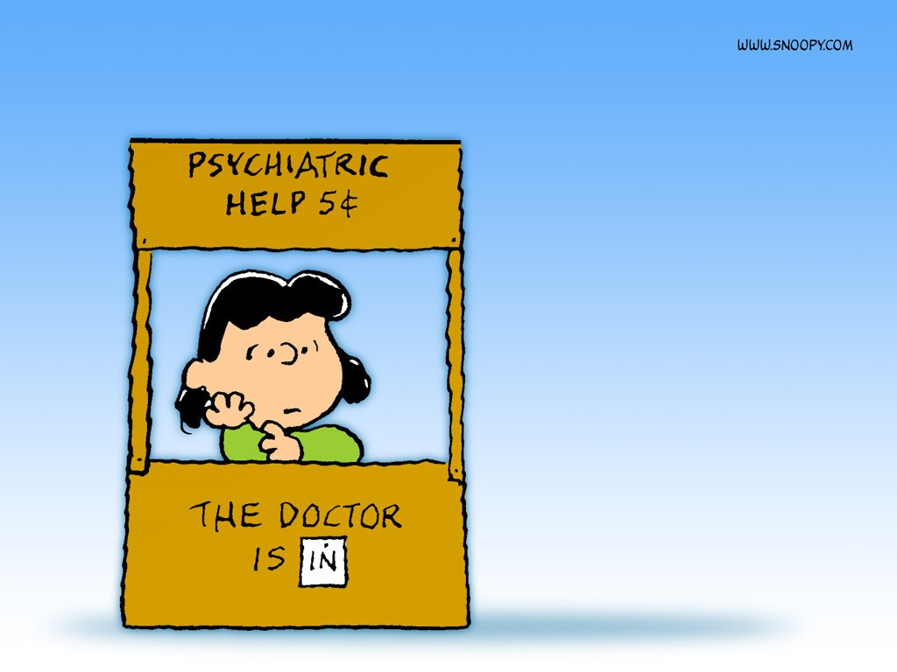
Appropriate Therapeutic Interventions
Appropriate emergency and crisis intervention
planning with local colleague available for
support;
Address adequate client safety in such situations;
Provision of remote and local backup in case of
counselor unavailability

Slide 37
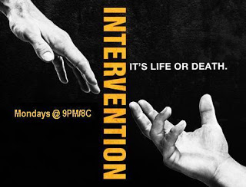
Appropriate Therapeutic Interventions
Assuring appropriate e-therapy environment
including safety, privacy, security, comfort minimal
distractions
Adequate discharge planning and follow-up referrals
Attention to multicultural issues and local customs
where the client resides

Slide 38
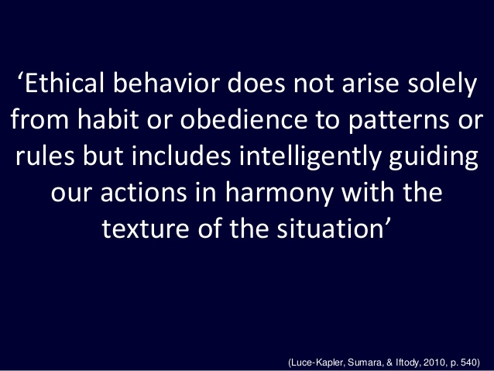

Slide 39
Vignette - Jake
Jake, an LPC, does long distance counseling from his home office in PA. He is counseling Jane, who is in the process of a divorce she does not want and experiencing depression and anxiety. Jane has 3 young children and is finding single parenting overwhelming since her husband left. Jane lives in Ohio and has little family support. She has been expressing escalating frustration with financial problems, needs to find a job and will require child care. She is feeling isolated from her friends. In today’s session she said she wasn’t sure she could do this much longer. As Jake began to pursue this further Jane was interrupted by her son who had come into the room crying and showing her a deep cut over his eye from falling while outside playing. She abruptly ended the session saying she had to take him to the emergency room for care.

Slide 40
Vignette - Pat
Pat, an SUD counselor, runs a Drug Court program for mandated clients. He has a personal Facebook page, limits his “friends” to family and close friends and uses all security measures. He does not “friend” clients who ask for this. Pat does not use chemicals but has an occasional beer. At a party Pat’s cousin takes a picture of him holding a beer and laughing, almost appearing drunk despite having had only one drink. His cousin posts this among other party photos on his wall. It turns out that one of the members of the mandated group is one of the cousin’s Facebook friends and sees the photo. The client shares the picture with other group members commenting: “What a phony! How can he help us? He is nothing but a drunk himself !” Pat, who rarely looks at his Facebook page, is unaware that his picture has been taken and posted by his cousin or that his clients have access to it.

Slide 41
Vignette - Madison
Madison is a new counselor at the XYZ treatment center. After her second week of employment one of the clients approaches her after group and asks to be removed from her group. Madison asks why and the client states, ‘I checked you out on Facebook and one of your pictures shows you with a guy that is my ex boy-friend. Are you going out with him?’ Madison tells the client she needs to talk with her supervisor about this issue and walks away. The client sits down on one of the chairs in the group room and begins to cry softly while other clients come over to see what is going on.

Slide 42
Vignette - Jerry
Jerry is a certified substance abuse counselor, an LCSW, and a clinical supervisor at a large behavioral health outpatient treatment program. He is 60 years old and has been with the agency for over fifteen years. An outpatient client approaches him with a complaint about one of the counselors, Michelle. The client reports that Michelle is checking the client’s Facebook page and Instagram site to determine if the client is telling the truth about their sobriety. According to the client, if Michelle sees pictures of the client out with friends that are drinking alcohol, she accuses the client of being dishonest and not working their program. The client says Michelle has no right to check her social network sites.

Slide 43
Vignette - Luis
Luis recently received a promotion at his treatment agency and is now committee chair for hiring two new counselors. After reviewing applicant resumes with this committee, four candidates are chosen for final interviews. Luis works with an administrative assistant to arrange the interviews. Before the first interview, the administrative assistant hands Luis copies of the applicants’ resumes and two-typed pages of notes. Luis looks at the notes and the administrative assistant says, ‘Oh, I completed an internet search on all of the applicants and typed a summary of my findings.’ Luis stops for a minute to contemplate his next steps.

Slide 44

Process Improvement/Take-Aways
1. Develop written practice policies and procedures
in regard to social media and digital technology
and incorporate these with the information provided
to clients before or during the initial session.
2. Build in up-front education of the client
about the pros and cons of e-therapy
to support informed consent.

Slide 45

Process Improvement/Take-Aways
3. Engage in training and education
about the use of social media and
digital technology in counseling
prior to engaging in such, including
implications and ethical concerns.

Slide 46


Process Improvement Take-Aways
4. Engage in continual supervision
and stay abreast of new treatment
interventions and advances in technology
through ongoing education.
5. When using technology, you must help
the client to understand this as well to
ensure comfort in engaging in e-therapy.

Slide 47

Process Improvement Take-Aways
6 . Utilize strong safeguards and secure
technology to protect ensure confidentiality and
secure access to client information, including
encryption and password protection
in all communication.
7. Use only secure methods of information transmission,
documentation, and data storage and disposal.

Slide 48

Process Improvement Take-Aways
8. Provide avenues for thorough screening and
assessment protocols to assure clients are
appropriate for virtual counseling.
9. Limit the use of information obtained
through digital technology and social
media sources (Google, Linked In,
Facebook, Twitter, etc.) in accordance
with procedures discussed with the
client prior to or at the start of services.

Slide 49

Process Improvement Take-Aways
10. Advise clients about appropriate
ways to communicate with them
and advise them about the potential
risks of sending messages through
social media and digital technology.

Slide 50

Process Improvement Take-Aways
11. Be hyperaware of what you post on any
social media and of the boundary
vulnerabilities of using unsecure technology.
Don’t put anything out there that you
would not be OK with if found by a client
or colleague or employer.
12. Limit information posted to that which does
not create multiple relationships or threaten
confidentiality.

Slide 51

Process Improvement Take-Aways
13. Develop effective plans for handling
emergencies/crises and develop local
contacts and procedures for referral
and intervention. Make sure you have
a local emergency contact for your
client.

Slide 52

Process Improvement Take-Aways
14. Employ thorough documentation
practices. Include all electronic
communications exchanged with
clients as part of the record,
even when related to clerical or
administrative issues.

Slide 53


Process Improvement Take-Aways
15. Be knowledgeable about and follow
all guidelines, regulations and laws
about licensure, confidentiality and
security of client information in your
state as well as the location of your client.
16. Know and follow your code of ethics
regarding the specifics of virtual counseling
and the use of social media.

Slide 54

Process Improvement Take-Aways
17. Have the availability of a knowledgeable
attorney and your own liability
insurance that covers e-therapy.
18. Develop a solid risk management plan
for your practice.

Slide 55


In Closing:
A good deal of thought and care must go
into how we use technology, given how it
may impact our clients and what it means
for our professional lives.
      Technology is here to stay and is likely to become an even more prominent methodology of service
      delivery.
With adequate training, supervision and adherence to ethical standards we can be prepared to handle what lies ahead to continue to serve our clients well.

Slide 56
Any questions before
we close today?
Thank you for participating
today!
      Have a safe trip home!

Slide 57
References
Ethics in E-therapy and TeleMental Health, Addiction Technology Transfer Center (ATTC): New Ethical Dilemmas in the Digital Age. Nancy A. Roget, MS, MFT, LAHC. University of Nevada. Webinar.
American Psychological Association. Guidelines for the Practice of Telepsychology, Adopted July 31, 2013.

Slide 58
References
American Association of Christian Counselors – AACC Code of Ethics – Y2014.
Distance Counseling, Technology and Social Media, Counseling Today, Sept 2014, pg. 23-25.
Journal of American Psychological Association, A New Emphasis on Telehealth, A. Novotney, June 2011,Vol 42,No. 6.

Slide 59
References
A Beginners Guide to Internet, Digital and Social Media Ethics for Counselors and Psychologists.
Dr. Kelly Kolmes, Australia Counseling, Webinar,
7/9/13.
Ethics in E-Therapy and TeleMental Health for Counselors. AllCEUS Counseling Education Webinar,10/25/13. Dr. Dawn Snipes. PhD, LMHC, CRC, NCC.

Slide 60
References
7 Ways to Legally and Ethically Expand Your Services with Evidence-Based Telehealth, Thomas Dunham, Ph.D.; NAADAC Webinar, 1/11/2017.
Best Practices for an Online World, Daniel G. Lannin & Norman A. Scott, Ph.D. American Psychological Association CE Corner, February 2014, Vol. 45, No. 2.
Georgia Telehealth Rule. Telehealth Certification Institute, Webinar, Raymond Barrett .

Slide 61
References
Ethics in an Online World, Mita M. Johnson, Ed.D., LAC, MAC. SAP; NAADAC Webinar: 4/17/2014.
An Introduction to Ethical Issues Online, APA, PACFA, APS, Australian Psychological Society, Webinar 11/17/2015.
On Line Therapy: The Practitioner’s Definitive Guide. Mark Tyrrell. http://unk.com/blog/the-definitive-guide-to-online-therapy/

Slide 62
References
U.S. Department of Health and Human Services (2014) Health Insurance Portability and Accountability Act of 1996 (HIPAA).
Using Technology and Online Counseling: The Future in Now. Oscar McKnight & Kerri Carmichael, Psychological Counseling Services, Ashland University; Gregory Pollock, John Carroll University

Slide 63
References
Professional Association Codes of Ethics and Guidelines on TeleHealth, E-Therapy, Digital Ethics, & Social Media. Ofer Zur, Ph.D., Zur Institute retrieved from http://www.zurinstitute.com/ethicsof telehealth.html.
Model Regulatory Standards for Technology and Social Work Practice. ASWB International Technology Task Force, 2013-2014

Slide 64
References
Some case studies from:
ATTC Training: Ethics in E-therapy and TeleMental Health, Addiction Technology Transfer Center (ATTC): New Ethical Dilemmas in the Digital Age. Nancy A. Roget, MS, MFT, LAHC. University of Nevada. Webinar.
Ethics and Social Media. PA Certification Board Annual Conference, 2014, Stephanie Murtaugh , MA, CAADC, CCS.

