Slide 1
The Evolving addiction workforce:
Strengthening our professional identity
Mary Jo Mather, Executive Director

Slide 2
To know where we are going,
we must know our past.

Slide 3
Where It All Began…
The addiction counseling profession has a rich history
Paraprofessionals were the pioneers
Little else but lived experience shared through recovery story-telling, mutual recovery support, counseling and community recovery resource development and linkage to treatment and AA
“Formal” credentials held by pioneers were personal recovery and a passion to help others recover

Slide 4
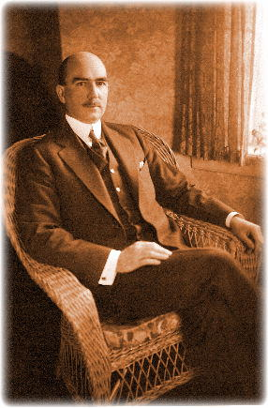
Courtenay Baylor
The first recovered alcoholic to work as a professionally paid lay alcoholism therapist was Courtenay Baylor in 1913
His unique credibility was that he was living proof that recovery was possible
Real results were being seen with his therapeutic ideas and practices
What else did he have? Tremendous charisma

Slide 5
Courtenay Baylor
His high success rate was also due to pre-qualifying potential clients based on their motivation to recover
His methods continued into the 1920s
More and more sobered alcoholics became lay therapists
Baylor treated and then trained Richard Peabody who wrote and produced “The Common Sense of Drinking” in 1931

Slide 6
Lay Therapists
The first addiction counselor to work within a multidisciplinary alcoholism treatment team was Francis Chambers
Mentoring other lay therapists was an essential part of each lay therapist’s responsibilities
Growing and sustaining the field—even back then!!

Slide 7
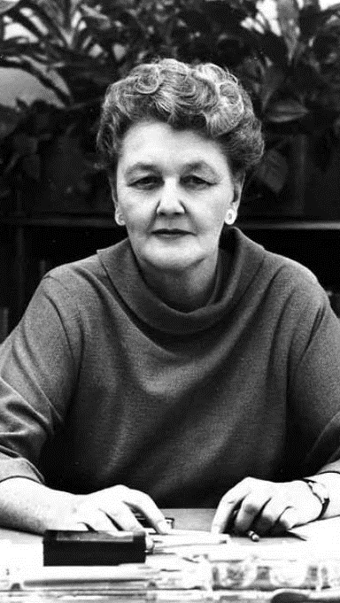
Prevention
1944 and Prevention enters the arena
National Council on Alcoholism and Drug Dependence (NCADD) was founded by Marty Mann—the first woman to achieve sustained recovery in AA
She believed alcoholism was a disease and should be treated as a public health issue
Marty Mann—our first Prevention Specialist? YES!
NCADD provided then, and still does today, alcohol and drug education and prevention

Slide 8
A Historical Perspective
1954: Dr. Ruth Fox established the NY City Medical Society on Alcoholism, now known as ASAM
The Minnesota State Civil Service Commission—the first body in the US to approve a state job classification for Counselor on Alcoholism
1957: Fordham University School of Social Services offered the first full university course on alcoholism for credit
1963-1966: Alcoholism and addiction counseling provision was included in federal legislation funding to develop local comprehensive community mental health centers, anti-poverty programs, and criminal justice diversion programs

Slide 9
More history…
The debate then began: Who is qualified to treat the alcoholic?
No surprise: Paraprofessional recovering alcoholics vs. psychiatrists, psychologists, and social workers
1974: Credentialing of counselors working in treatment programs began with a divide of alcoholism counselors and drug counselors (treated as separate fields throughout most of the 20th century)

Slide 10
(even) More history…
Integration of alcoholism and drug treatment did occur during the ‘80s as did credentialing of both with one credential
Professionalism of the workforce led to:
State and national trade associations
Certification and licensing requirements
Addiction studies programs in colleges
Continuing education resources
Improved salaries/benefits
‘70s and ‘80s marked the transition from a field of paraprofessionals to clinical professionals on par with other recognized helping roles

Slide 11
Today’s Workforce Characteristics
/
White, female, over age 45
29% of direct staff is in recovery
36% master’s degree; 24% bachelor’s degree
Median annual wage in 2017 = $43,300
DOL expects a 23% growth for substance use disorder counselors between 2016-2026

Slide 12
Workforce: What do we need?
2016: Total workforce 260,200
2026: Total workforce needed 320,500
Younger professionals from diverse racial/ethnic backgrounds are needed

Slide 13
COMPENSATION
Certified counselors, no degree: $39,776
Certified counselors, Bachelor’s degree: $43,830
Certified or licensed counselors, Master’s degree: $52,898
2016 Survey of National Treatment Providers

Slide 14
Workforce: longevity
54% of the addiction workforce as been working at their facility for less than 5 years
24% have worked for their employer for 5 to 10 years

Slide 15
TOP 10 LIST!
10 best states to work or live in for SUD counselors:
Study ranked on:
Average income
Projected employment growth
Cost of living
Alcohol use rates
Illicit drug use rates
Substance abuse-related arrest statistics

Slide 16
DRUM ROLL PLEASE! The best states for counselors are…
Colorado
Nevada
Montana
Minnesota
Iowa
Idaho
Wisconsin
New Hampshire
Wyoming
Virginia
Sorry PA, you did not make the Top 10 list!!!

Slide 17
Tell me more about Pennsylvania!
Pennsylvania ranks 2nd highest in the number of behavioral health professionals available to treat drug and alcohol addiction in the US.
20,930 SUD counselors employed
Annual mean wage: $44,270

Slide 18
Certifications offered
Counselor
Prevention
Clinical Supervisor
Allied Addiction Practitioner
Intervention Professional
Recovery Specialist
Family Recovery Specialist
Peer Specialist
Disaster Crisis Outreach & Referral

Slide 19
By the numbers: a snapshot of active credentials
Counselors: 2,568
Clinical Supervisors: 117
Prevention Specialists: 74
Peer Specialists: 1,746
Allied Addiction Practitioners: 141
Recovery Specialists: 1,378
Total active credentials & endorsements: 6,624
Total professionals: 5,784 *as of 3/29/2019

Slide 20
Certified professionals: demographics
Gender:
58% Female
41% Male
Race:
73% Caucasian
20% African American
Education:
45% Master’s degree
29% Bachelor’s degree
Age:
18% 35 or younger
45% 36-54
36% 55 or older

Slide 21
Where to Make the Most Money?
2017 annual mean wage:
Utah: $67,160
Alaska: $62,030
Oregon: $57,420
New Jersey: $57,200
Wyoming: $56,850

Slide 22
Chronic Problem: Recruitment
Insufficient number of applicants who are qualified
Varied qualifications to be met
Lack of racial and ethnic diversity of applicants
Challenging regulations/policies that vary from state to state
Paperwork/documentation
STIGMA: Yes, clients face stigma, but so does staff in our field
Even harder to recruit applicants to work in rural and frontier areas

Slide 23
Chronic Problem: Retention
Average staff turnover: 18.5%
Salary satisfaction is unsatisfactory
Good quality supervision lacking
Lack of training opportunities
Large caseloads
Little to no promotion opportunities
Lack of mentoring
Non-supportive facility culture

Slide 24
The Impact of DC
What goes on in Washington, DC as it relates to substance use disorders and the workforce often trickles down to every state and impacts what and how you provide treatment and prevention services
Knowing who the federal partners are and issues they are addressing can provide much needed background to why certain decisions are made in states and local communities

Slide 25
Substance Abuse & Mental Health Services Administration US Department of Health & Human Services
Mission is to reduce the impact of substance abuse and mental illness on America’s communities
In existence since 1992; headquarters in Rockville, MD
SAMHSA’s four Centers include:
Center for Behavioral Health Statistics and Quality
Center for Mental Health Services (CMH)
Center for Substance Abuse Prevention (CSAP)
Center for Substance Abuse Treatment (CSAT)

Slide 26
Strategic Initiative on Workforce Development: Goals
Develop/disseminate workforce training and education tools and core competencies to address behavioral health issues
Develop and support deployment of peer practitioners in all public health and health care delivery settings
Develop consistent data collection methods to identify and track behavioral health workforce needs
Influence and support funding for the behavioral health workforce

Slide 27
What Concerns SAMHSA about Workforce?
Shortages
Retention/recruitment efforts
Serving diverse populations with a workforce that matches these diverse populations
Advancement of evidence-based practices

Slide 28
SAMHSA Resources
Available free of charge:
Treatment Improvement Protocols (TIPs)
Technical Assistance Publications (TAPs)
Webinars and listening sessions
Reports and national surveys
Grants, data, technical assistance
Toolkits

Slide 29
Recovery Month
Every September, SAMHSA sponsors Recovery Month to increase awareness and understanding of mental and substance use disorders and celebrate the people who recover.
www.recoverymonth.gov

Slide 30
HRSA: Health Resources & Services US Department of Health & Human Services
HRSA is the primary federal agency for improving access to health care by strengthening the health care workforce, building healthy communities and achieving health equity
HRSA’s programs provide health care to people who are geographically isolated, economically or medically vulnerable

Slide 31
HRSA, continued
HRSA also supports the training of health professionals, the distribution of providers to areas where they are needed most and improvements to health care delivery
DATA driven—Loans and scholarships for workforce—Grants for health care programs
MDS—collecting data on all professionals that touch substance use disorder
www.hrsa.gov

Slide 32
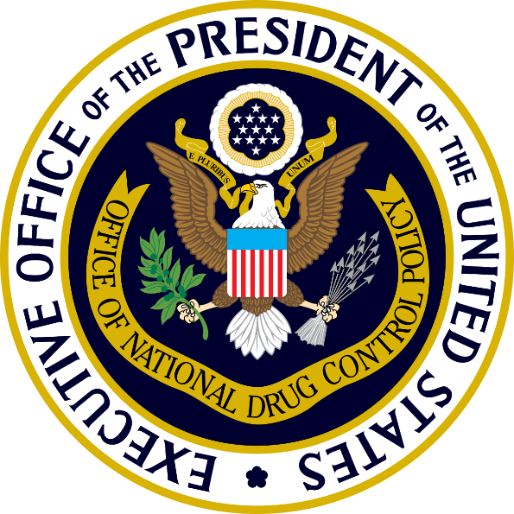
ONDCP: Office of National Drug Control Policy
Executive Office of the President within the White House
ONDCP was created by the Anti-Drug Abuse Act of 1988
ONDCP works to reduce drug use and its consequences by leading and coordinating the development, implementation, and assessment of US drug policy
ONDCP also provides administrative and financial support to the President’s Commission on Combatting Drug Addiction and the Opioid Crisis, established by Executive Order on March 29, 2017, by President Donald J. Trump

Slide 33
The National Drug Control Strategy
Prevention
Treatment and Recovery
Reducing the availability of illicit drugs in the US

Slide 34
Prevention
Nationwide Media Campaign
Safe Prescribing Practices
Use of Prescription Drug Monitoring Programs
Capacity of State, Local, and Tribal Communities to Identify and Prevent Substance Abuse
Research and Development of Evidence-Based Prevention Programs
Strengthen ONDCP’s Drug Free Communities Program
Expanding Drug Take-Back

Slide 35
Treatment & Recovery
Improving
Improving Overdose Response
Enhancing
Enhancing Evidence-Based Addiction Treatment
Eliminating
Eliminating Barriers to Treatment
Increasing
Increasing the Size of the Addiction Service Workforce and Treatment and Recovery Infrastructure
Leveraging
Leveraging Drug Courts and Diversion Programs
Increasing
Increasing Employment Opportunities for Those in Recovery
Expanding
Expanding Access to Peer Recovery Support Services
Expanding
Expanding the Scientific Understanding of Peer Recovery Support Services
Reducing
Reducing Stigma and Making Recovery Possible

Slide 36
Reducing Illicit Drugs
Disrupting, Dismantling, and Defeating Drug Traffickers
Working with International Partners
Combatting Illicit Internet Drug Sales
Focusing Federal Government Effort Against Illicit Drug Delivery through the Mail and Express Consignment Networks
Interdicting the Flow of Drugs Across the Physical Borders and into the US
Disrupting and Dismantling the Illicit Drug Production Infrastructure
Leveraging the Full Capabilities of Multi-Jurisdictional Task Force Programs
Interrupting the Financial Activities of Drug Traffickers
Enhancing Law Enforcement Capacity

Slide 37
NIDA: National Institute on Drug Abuse
Established in 1974, under the National Institutes of Health
NIDA’s mission is to lead the nation in bringing the power of science to bear on drug abuse and addiction
How?
By the strategic support and conduct of research across a broad range of disciplines
By ensuring the rapid and effective dissemination and use of the results of that research to significantly improve prevention and treatment and to inform policy as it relates to drug abuse and addiction

Slide 38
NIDA
For professionals:
Research studies and reports
DrugFacts
E-newsletters
Journals
Education materials
Podcasts

Slide 39
NIAAA: National Institute on Alcohol Abuse & Alcoholism
Supports and conducts research on the impact of alcohol use on human health and well-being
It’s the largest funder of alcohol research in the world

Slide 40
NIAAA: How?
Conducting and supporting research in a wide range of scientific areas including genetics, neuroscience, epidemiology, health risks and benefits of alcohol consumption, prevention and treatment
Coordinating and collaborating with other research institutes and federal programs on alcohol-related issues
Collaborating with international, national, state, and local institutions, organization, agencies, and programs engaged in alcohol-related work
Translating and disseminating research findings to health care providers, researchers, policymakers, and the public

Slide 41
NIAAA
For professionals:
Publications, brochures, fact sheets
Research
Clinical trials
Grants
Journals and videocasts
Educational materials

Slide 42
Climate in DC
A cultural shift in Congress has emerged on addiction; more willingness to deal with addiction-related issues in a bi-partisan manner
Recent public attention given to the opioid epidemic is creating motivation for lawmakers to care about addiction
This short window of opportunity must be seized!

Slide 43
Feds Watching Closely
Opioid epidemic
Marijuana legalization in states and its impact on prevention, treatment, crime, etc.
Integration of SUDs into primary health

Slide 44
What Else in DC about Addiction?
Language shift needs to occur to stop the stigma
Stop the negative and blaming language such as addicts, abusers, etc.
Instead use “people with substance use disorders”

Slide 45
Other Federal Partners
U.S. Department of Transportation (DOT)
Assessment and referral required for DOT employees for violation of drug and alcohol regulations

Slide 46
Department of Justice
Treatment for SUDs and mental health in prisons
Crime related to alcohol and drug use
Diversion programs and drug courts
Shift towards treatment, not incarceration

Slide 47
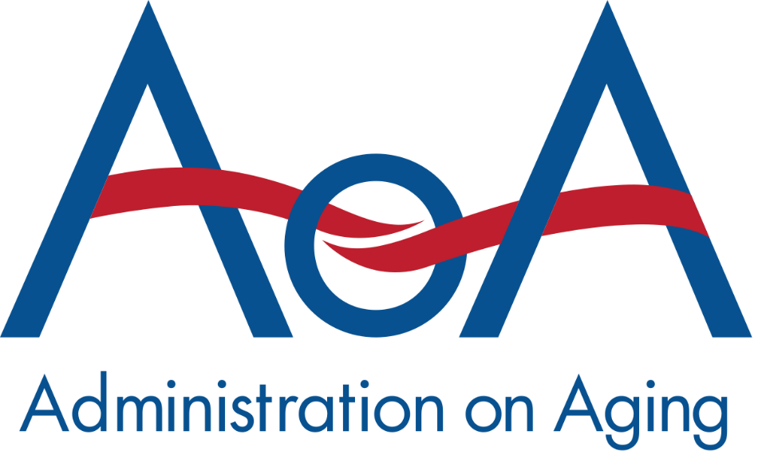
Administration on Aging (AOA)
Alcohol abuse is the biggest problem among older adults, but illicit drug use for 50-64 year-old adults is rising

Slide 48
Department of Veteran Affairs (DOVA)
Access to treatment for veterans with SUDs is on the rise, a critical issue facing our federal government

Slide 49
What are we seeing moving forward?
Treatment centers abandoning expansion plans due to inadequate supply of clinical staff
Higher wages must be a priority to recruit and retain clinical staff
Good leadership for clinical staff is critical
More money toward treatment of opioids will require a demand for evidence-based practices to be used and more accountability that treatment works
The need for addiction counselors to be ready to work in a variety of health care settings with a variety of other health care professionals (treatment is no longer happening only in formal treatment settings)

Slide 50
There’s more to do!
Increase use of evidence-based practices and recovery-oriented methods
Need for the most skilled, knowledgeable, ethical, and competent workforce on par with other health care professionals
Embrace, implement and use electronic health information technology
Advocate for loan repayment legislation (DONE)
WE MUST CONTINUE TO ADVOCATE for recognition of SUDs as a valid health issue TREATED LIKE ALL OTHER HEALTH ISSUES

Slide 51
Final Thoughts
You save lives
You transform lives
There is no higher calling
THANK YOU – YOU ROCK!!!!!

Slide 52
P: 717.540.4455
E: info@pacertboard.org
W: www.pacertboard.org

