Slide 1
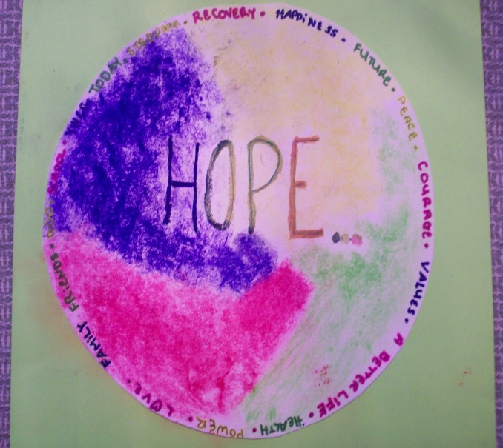
Regulating the Co-Occurring Adolescent & Young Adult through the Application of DBT Skills
Erin Goodhart, LPC, CAADC, ACRPS, CCS, CSAT candidate
Clinical Director of Women’s Continuum at Caron Treatment Centers
Cheryl Knepper, LPC, ATR-BC, ICCDPD, CSAT-S, CMAT
VP Clinical Services, Caron Treatment Centers

Slide 2
Goal of Workshop
The goal of this presentation is to provide a workshop format that offers the attendee the opportunity to learn and practice DBT skills that can be utilized with the adolescent and young adult co-occurring populations. The goal is for each attendee to have a basic understanding of the theory and practice of DBT.

Slide 3
Educational Objectives
The participant will:
be able to cite research regarding the use of DBT with the co-occurring adolescent and young adult populations
Demonstrate through practice the use of mindfulness, diary cards and behavioral chain analysis
Understand the complexity of treating co-occurring addiction and mental health disorders commonly found in adolescence and young adulthood
Understand the Bio-psych-social model of treating behavioral health disorders
Present skill and then practice skill with other workshop attendees, design a treatment plan that includes DBT interventions
Identify the Basic principles of DBT
Apply multiple skills including distress tolerance, interpersonal skills, mindfulness and emotional regulation with co-occurring disordered young people

Slide 4


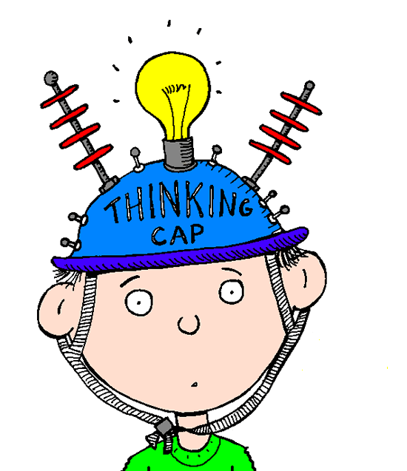
Dialectical Behavioral Therapy

Slide 5
So What is DBT?
Dialectical Behavioral Therapy-skills based approach
Marsha Linehan-1993, evidence based and well researched
BioSocial Theory that the problem behaviors often seen in individuals stem from a combination of biological and environmental factors
Bio- predisposition, vulnerable to high sensitivity and reactivity, intense emotion and difficulty regulating example-Alcoholic Family
Social-learned in the environment, home, school, peers
Skills training for adolescents-(2015) Jill Rathus and Alec Miller-DBT skills Manual for Adolescents

Slide 6
Why DBT for Adolescents and young adults struggling with Co-occurring Disorders?
Evidence based intervention
Provides specific coping skills
  For triggers to use
  To shorten relapse if it occurs
Overlaps with 12 step approaches when treating co-existing addictions

Slide 7
Who benefits from DBT Skills ?
Young people who engage in self-harm behaviors such as:
Substance Use Disorder and Behavioral addictions
Suicidal acts
Suicidal thoughts
Cutting, burning and other self-injurious activities
Eating disordered behavior

Slide 8

DBT Functions-the Big 5
Enhancing Capabilities
Improving motivation to change
Assuring generalization to environment
Structuring the environment
Enhancing therapist capabilities and motivation to treat-We are an agent of proactive change-own supervision

Slide 9
DBT Basic Assumptions
Patients are doing the best that they can
Patients want to improve
Patients need to do better, try hard, and be more motivated to change
Patients may not have caused all their own problems but they have to solve them anyway
The lives of suicidal, borderline individuals are unbearable as they are currently being lived
Patients must learn new behaviors in all relevant contexts
Patients cannot fail in treatment
Therapists treating patients need support

Slide 10
DBT Directly Addresses these Factors:
Increasing the teen and teen’s families capabilities by teaching specific skills for self regulation
Improving interpersonal effectiveness
Increase distress tolerance
Improve balanced thinking and acting rather than reacting
Structure the environment to assist in motivation, reinforcement
Patient centered approach to individualized use of skills

Slide 11
Modules
Skills based approach that offers 4 sets of skills plus one specific to Adolescents (Miller)
Mindfulness-awareness of self and others, make wise decisions, focus, avoid judgements
Distress Tolerance- 2 subsets, Crisis Survival and Accepting reality-coping through difficult situations without doing harm and change what you can and accept what you cannot change
Emotion Regulation-emotional awareness, balance, confidence building
Interpersonal Effectiveness-communication and relationship skills, assertiveness, healthy relationship building and increase self respect in relationships
WALKING THE MIDDLE PATH

Slide 12
Dialectical dilemmas in adolescent DBT
Forcing independence
Making light
of problems
behaviors
Too strict
Too loose
Making too
much of typical
adolescent behavior
Fostering independence

Slide 13
Adolescent DBT Treatment Cycle Skill Building
Distress Tolerance
Mindfulness
Mindfulness
Mindfulness
Walking the Middle path
Interpersonal
Effectiveness
Mindfulness
Mindfulness
Emotion Regulation

Slide 14

Mindfulness Module: requires daily practice!

Slide 15
DBT conceptualizes the emotionally dysregulated adolescent
Self dysregulation---------------------DBT Skill Core Mindfulness
  identity confusion/difficulties
  sense of emptiness
  lack of awareness of thought/emotion/behavior

Slide 16
When we are Mindful, we can:
Notice our thoughts without being overwhelmed by them
Make planned decisions & avoid impulsivity
Be focused on, appreciate and enjoy the fun times
Feel more calm within your mind and body-even during stressful times
Act effectively and feel better

Slide 17
Mindfulness is opposite of Mindlessness.
When we are mindless, we:
Don’t notice our thoughts and get overwhelmed easily, increasing anxiety, depression and anger
Are less likely to think about decisions and act impulsively
Are more likely to miss out on enjoyment and having fun because of worry or distraction
Increase impact of stress
Might not be able to use skills to assist self when you really need them

Slide 18
Mindfulness Skills List
What Skills: How Skills:
Observe *Non-Judgmental Stance
Describe *One-Mindfully
Participate * Effectively

Slide 19
Mindfulness: Three states of Mind
Reasonable Mind
Emotional Mind
W
I
S
E
M
I
N
D

Slide 20

Mindfulness Activities

Slide 21

Are You…
Mindfulness allows for us to be in the moment because it is the only moment we have. In using skills such as DBT, 12-steps, life-skills, addiction-recovery skills, we only have this moment in which to use them effectively and skillfully.

Slide 22
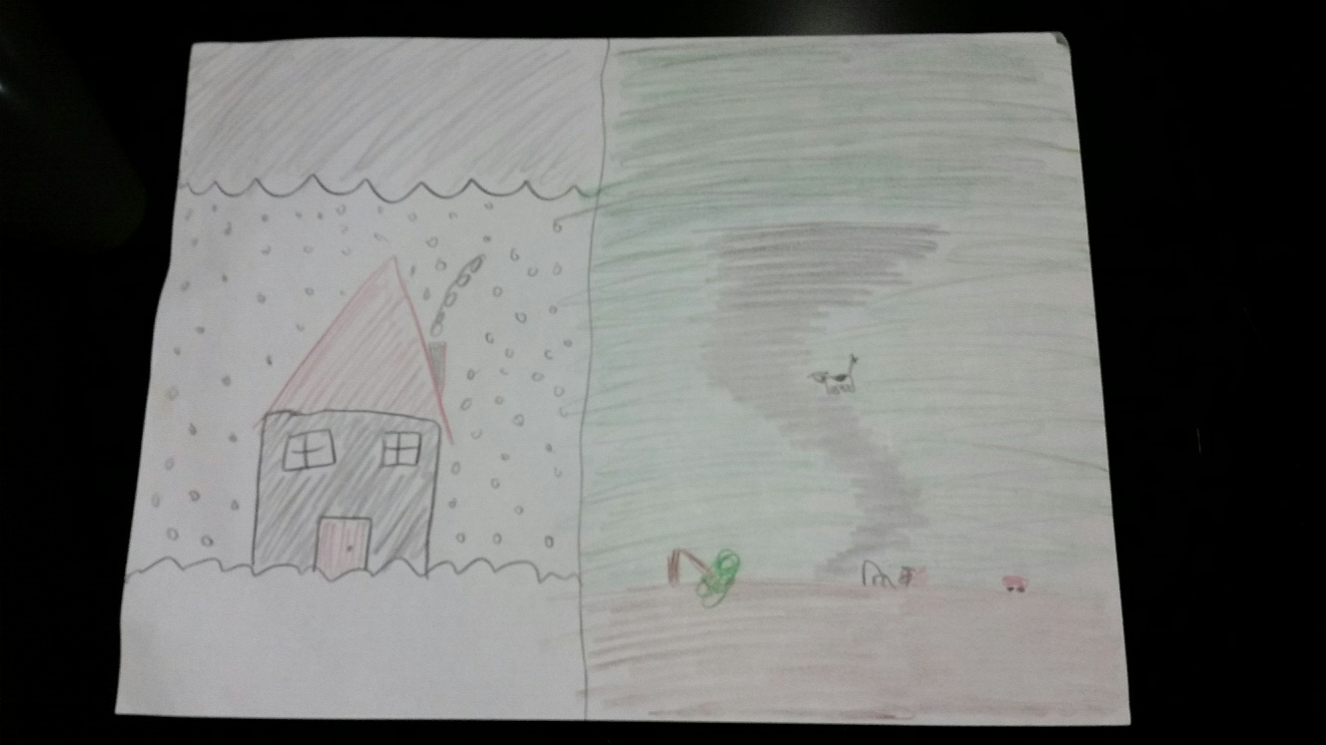
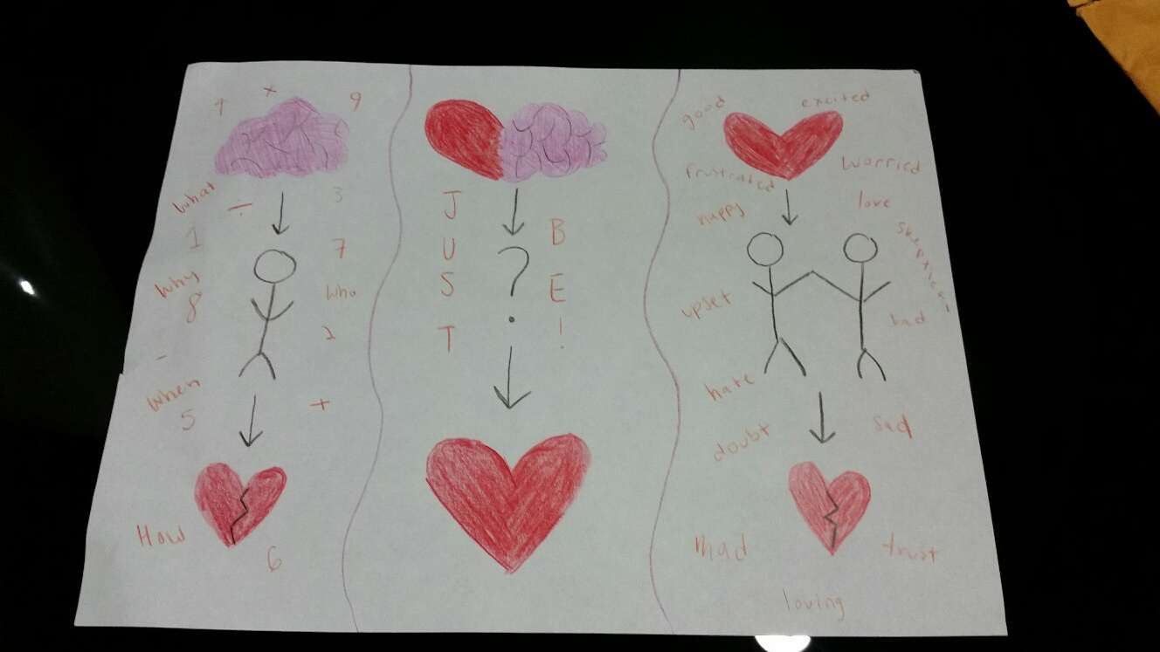
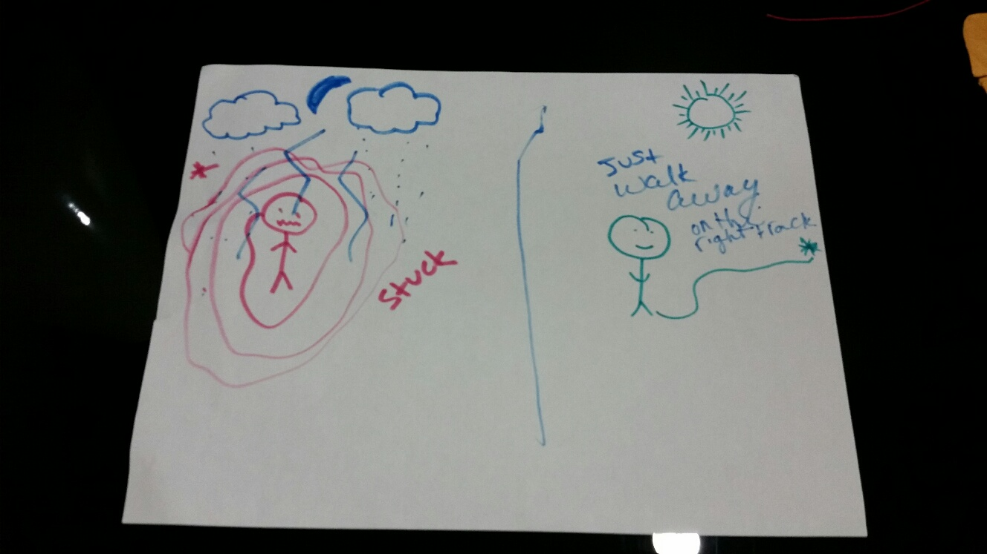
Three states of mind drawing

Slide 23
Three States of Mind Practical Application
Introduce the three states
Activity: Stressful Event-individual or group activity
Give an example of a stressful event (walking down the hallway)
  How would you respond
  Split into 2 groups and write pros/cons of the reaction
  Emotional mind – laughing and distracted. Reasonable mind – right to business
Start each group with where found themselves in the last week

Slide 24
Observe, Describe & Participate
Activity: Mystery Bags-group activity
Discussion questions:
What was it like to use observe and describe? What did you learn about yourself or your environment?
What was it like to participate without acting on urges?
How do you think this could be helpful?
How could you use Observe, Describe & Participate in your day to day tasks and interactions?

Slide 25

Distress Tolerance Module

Slide 26
DBT conceptualizes the emotionally dysregulated adolescent
Behavioral dysregulation---------DBT Skill Distress Tolerance
  Para suicidal/ suicidal behavior
  impulsive behaviors including: ED behavior, alcohol/drug use behavior, risky sexual behavior

Slide 27
Distress Tolerance Skills
Help tolerate emotional pain not remove the pain
2 types of skills
  Crisis Survival: Situation cannot be avoided
    Goal is not to make the situation worse
  Acceptance:
    Goal is to accept painful situations rather than avoid or fight them
Notes:
Pg 421 training manual

Slide 28
Distress Tolerance: Distract with Wise Mind
Rate current level of distress
A: Activities
C: Contributing
C: Comparisons
E: Emotions
P: Pushing Away
T: Thoughts
S: Sensations
Notes:
PG 439 in training manual

Slide 29
Distress Tolerance Module Skills List
Crisis Survival Skills: Accepting Reality Skills:
Wise Mind Accepts Pros & Cons
Self-soothe Radical Acceptance
Improve the Moment Turn the Mind
Half Smile Willingness
Creative outlet

Slide 30

Distress Tolerance Activities

Slide 31
Distress Tolerance: Self-Soothe Skills
  Vision
  Hearing
  Smell
  Taste
  Touch
  Movement-Kinetic
Activity: Develop a Self-Soothe kit
Notes:
Different stations

Slide 32
Distress Tolerance Skills
Activity: Imagery “My Happy Place”
Design a collage through cutting out pictures or gather from pre cut images that represent a place that is happy and pleasant
Discuss what elements make this place safe and happy, post collage in a place that will be a reminder

Slide 33
Distress Tolerance Skills
Activity: “One Thing at a Time”
One thing at a time skill helps improve the moment by focusing on only one step at a time
Jenga game with questions related to tolerance and destressing-focus on one piece at a time and waiting turn, in turn focusing

Slide 34

Emotional Regulation Module

Slide 35
DBT conceptualizes the emotionally dysregulated adolescent
Emotional Dysregulation---------------DBT skill Emotion Regulation
  emotional vulnerability
  affective lability
  problems with anger
  Steady negative emotional states

Slide 36
Emotional Regulation
Goal is to reduce emotional suffering not get rid of emotions
Notes:
Pg323 training manual

Slide 37
Emotional Regulation: What do Emotions do for Us ?
Emotions give us information
Emotions communicate to, and influence, others
Emotions motivate and prepare us for action

Slide 38
Emotional Regulation: Check the Facts
What is the emotion I want to change?
What is the prompting event for my emotional reaction?
  Describe the prompting events
  Look for extremes and judgements and rewrite the facts
What are interpretations about the facts?
  List as many other possible interpretations of the facts

Slide 39
Check the Facts (cont.)
Am I assuming threat?
  List as many other possibilities as possible
What’s the catastrophe, even if the outcome I am worrying about does occur?
  Describe ways to cope
Does my emotions fit the fact?
  What did you do the check the facts?

Slide 40

Emotion Regulation Activities

Slide 41
Emotion Regulation
Activities in this module are intended to evoke emotions so that clients can learn how to improve their ability to identify, experience and express emotions.
These activities are often paired with distress tolerance activities so that when difficult emotions surface the individual is able to work through the emotion in a health non harming manner.

Slide 42
Emotion Regulation Activities
Activity: Emotions Ball
The goal of this activity is to observe and describe emotions
Using a soccer ball and sharpie write feelings words on the edges of the ball prior to activity
Write the following ?’s on a white board:
Share a time when you experience this emotion
What did you notice about your body or thoughts
When was the last time you had this emotion
What is it like to have someone else around you express this emotion
How do you think observing and describing emotions could be helpful in your daily life

Slide 43
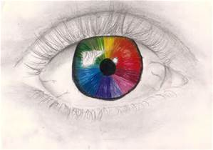
Interpersonal Effectiveness

Slide 44
DBT conceptualizes the emotionally dysregulated adolescent
Interpersonal dysregulation------------DBT Skill Interpersonal Effectiveness
  chaotic/unstable relationships
  chronic family disturbance
  social isolation

Slide 45
Interpersonal Effectiveness Activities
Activity: Cheerleading Statements
Give courage to do things when times are tough
Make you stronger and ready for action
Fight off untrue thoughts
“I am ok!” “I can do it!” “I am Strong!”
“I will be ok!” “This is my Choice!”

Slide 46
Interpersonal Effectiveness
Activities
Activity: Communication-Dear Man (art negotiation)
D-describe, list the facts, pit into words
E-express, talk about feelings, I statements, What you want what you want
A-assert, Say exactly what you want and accept “NO” sometimes
R-reinforce. Use examples and what will the other person get out of the deal
M-Be mindful, focus, clear calm approach, listen, be present
A-appear confident-eye contact, speak clearly, do not beat around the bush
N-negotiate, discuss options, be open to others suggestions, be willing to give to get. Have other ideas in mind

Slide 47
Interpersonal Effectiveness Activities
Activity: How to Keep a Good Relationship (Give Chart)
Be Gentle
Act Interested
Validate (role play)
Use and Easy Manner

Slide 48

Walking the Middle Path

Slide 49
DBT conceptualizes the emotionally dysregulated adolescent
Cognitive dysregulation and family conflict--- DBT Skill Walking the Middle Path
  chronic invalidation of self and others
  pervasive non-dialectical thinking
  poor conflict resolution

Slide 50
Middle Path Skills
Adolescent Specific skills
These skills bridge the gap between acceptance and change
These skills focus on 3 core areas:
  Dialectics
  Validation
  Behavior change

Slide 51
Invalidating Environment
An environment that pervasively negates or dismisses behavior independent of the actual validity of the behavior (often well-meaning)-family members, teachers, healthcare pro----------discontentment, irritability and hopelessness
Characteristics:
  Indiscriminately rejects communication of private experiences and self-initiated behaviors-person’s experiences are trivialized, not validated or punished
  Intermittently reinforces escalation of emotional responses-removing demands after an incident-codependent
  Over-simplifies ease of problem solving rather emphasizing the need to control emotional expressiveness-intolerant of displays of negative affect-acting in or acting out

Slide 52
Consequences of Invalidation
Environment does not teach individual to:
- label private experience in a normative
fashion (self-validate)
- to effectively regulate emotions
- to trust experiences as valid
- accurately express emotions
- communicate pain effectively
- tolerate distress
- solve difficult problems in living (resolve family conflict)
- use shaping and other behavioral strategies
to effectively regulate own behavior

Slide 53
Invalidating Environment
Environment does teach the individual to:
- actively self invalidate
- oscillate between emotional inhibition
and extreme emotional displays
- respond with high negative arousal to
to failure
- form unrealistic goals and expectations
- hold perfectionistic standards

Slide 54
Key points in deciding which DBT skills to teach
Develop skills curriculum with the right focus and fit for the length of stay and target population
Skills taught should target the behaviors that typically lead to the inpatient/residential admission
Whatever skills are chosen, teach them twice
Staff should learn the skills and practice them themselves in order to be able to provide
Effective coaching

Slide 55
Steps to Planning a Skills Curriculum
Determine how much time you have to teach based on length of stay
Decide who you want to include in the skills training (teens only/family and teens/family only)
Multiple family groups/ parents taught separately
Decide which skills you want to teach
Decide which handouts and worksheets you want to use

Slide 56
Providing Feedback & Coaching
Be behaviorally specific!
Focus on client's performance, not motives
Do not remove cue when client is over-sensitive to feedback
Balance negative feedback with positive feedback
Use shaping to encourage successive approximations
Identify client's patterns of skill use over time

Slide 57

The Goal of DBT for the Young person …is a Life Worth Living!

Slide 58
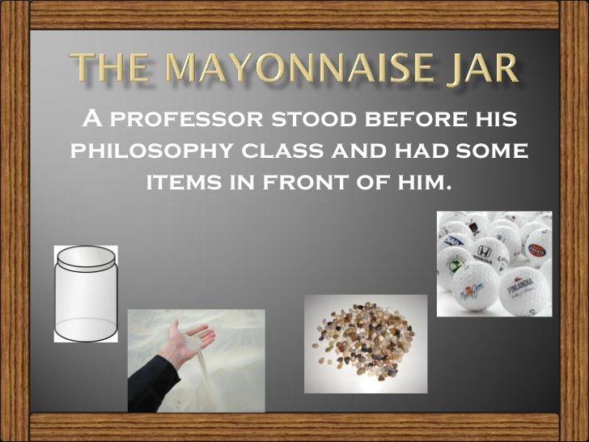
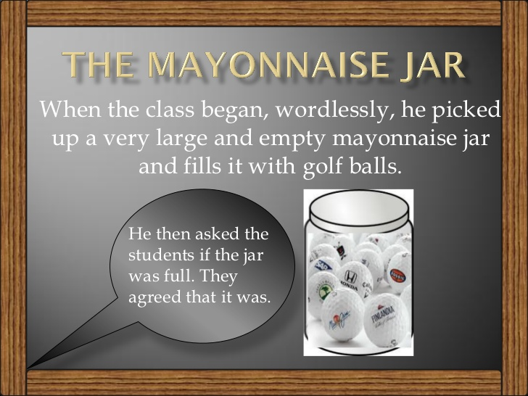
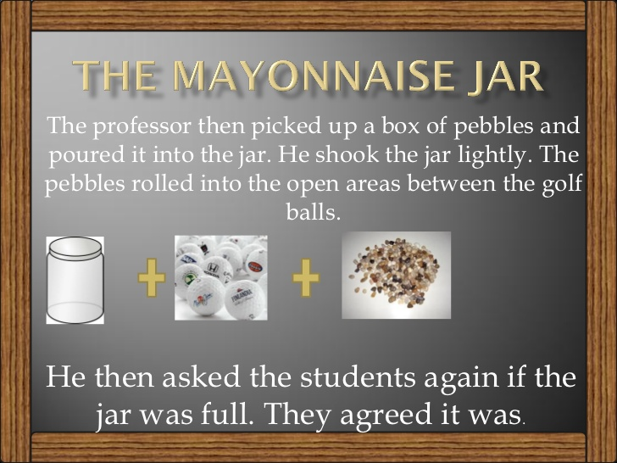
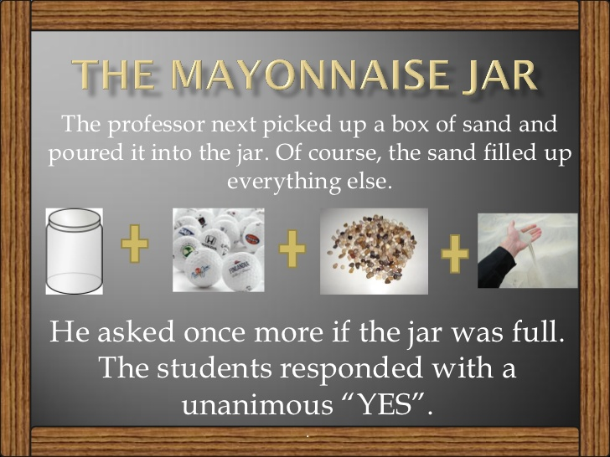
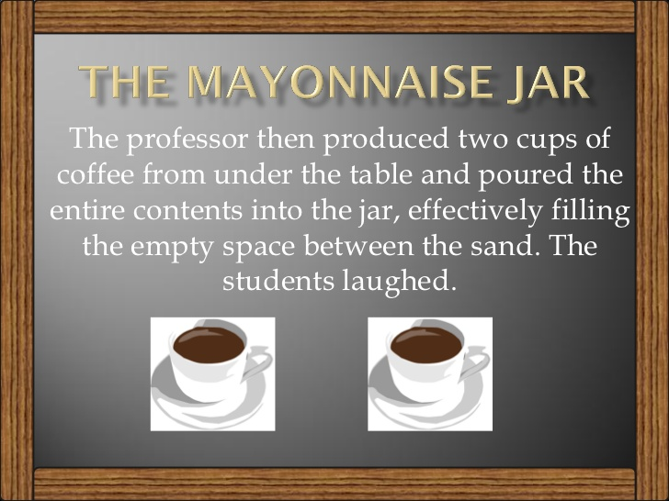
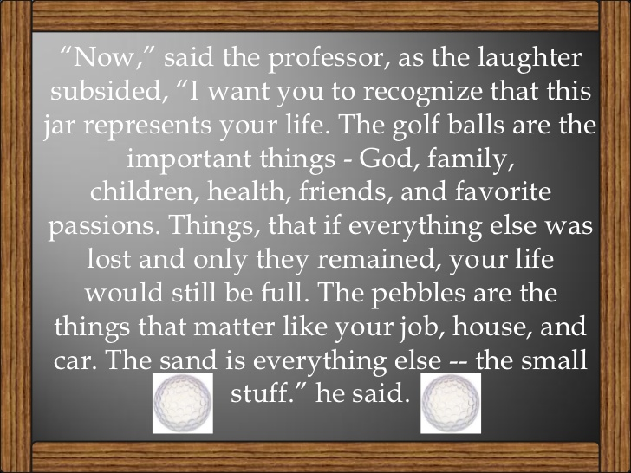
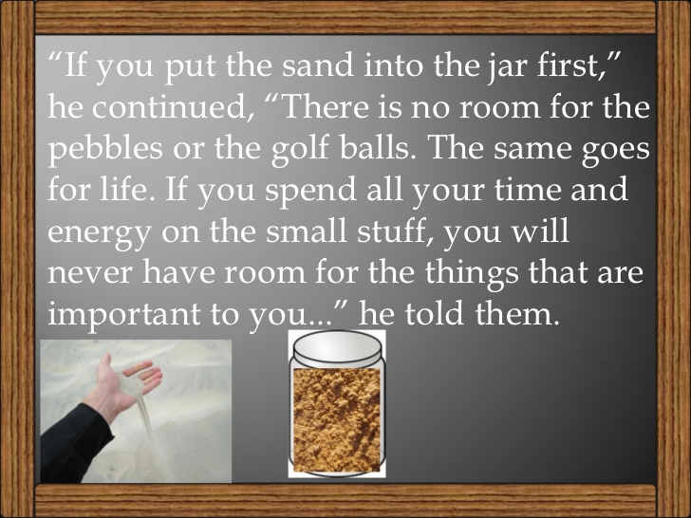
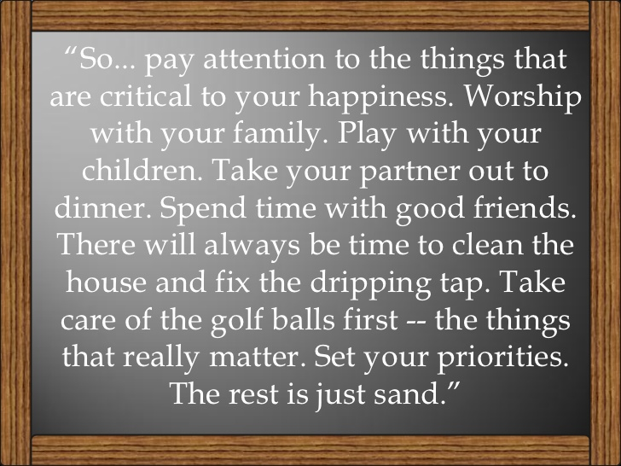
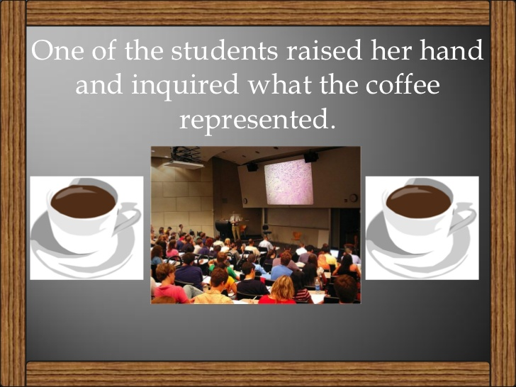
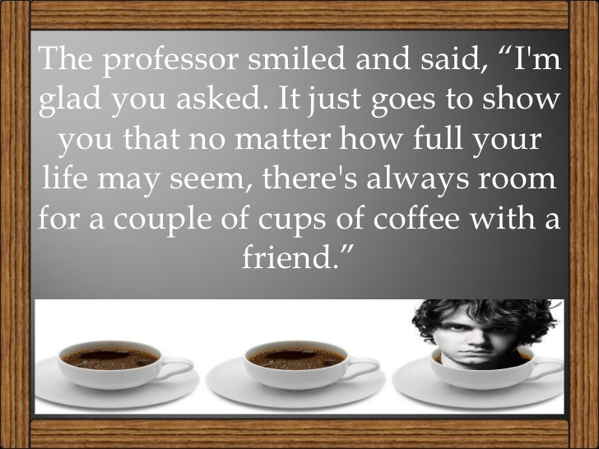
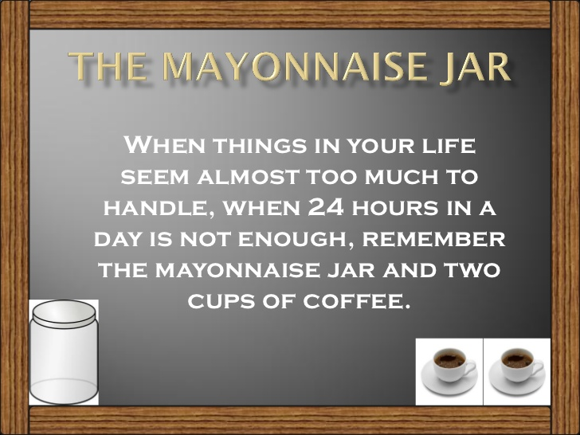
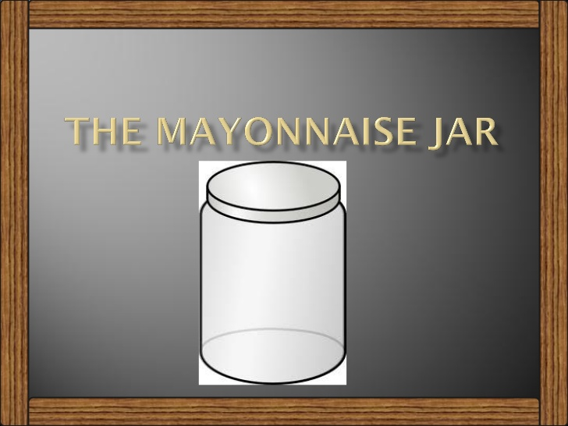

Slide 59
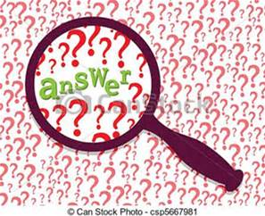

Slide 60

Thank You
Follow us on social media!
@CaronTreatment
Facebook.com/Caron
YouTube.com/Caron

Slide 61
References
Abney-Cunningham, G. (2012) Getting to the Heart of the Problem: Targeting, Assessing, and solving problem behaviors. (Power point presentation).
Dimeff, L. & Koerner, K. (2007) Dialectical behavior Therapy in Clinical Practice: Applications across disorders and settings. New York: The Guildford Press
Dimeff, L. & Reynolds, S. (2007) Dialectical Behavior Therapy: Intensive training course. (Power point presentation).
Eells, T.D. (1997) Handbook of Psychotherapy Case Formulation, Chapter 13: Case Formulation in Dialectical Behavior Therapy; p. 340-367
Koerner, K (2012) Doing Dialectical Behavior Therapy p.111-138. New York: The Guilford Press

Slide 62
References
Kelly, J.F., Brown, S.A., Abrantes, A., Kahler, C., Myers, M.G. (2008). Social recovery model: An 8 year investigation of adolescent 12-step group involvement following inpatient treatment. Alcoholism: Clinical and Experimental Research, 32(8), 1468-1478.doi:10.1111/j.1530-0277.2008.00712.x.
Kelly, J.F., Urbanoski, K. (2012). Youth recovery contexts: the incremental effects of 12-step attendance and involvement on adolescent outpatient outcomes. Alcoholism: Clinical and Experimental Research, 36(7), 1219-1229. doi: 10.1111/j.1530-0277.2011.01727.

Slide 63
References
Mundt, MP, Parthasarathy, S, Chi, FW, Sterling, S, Campbell, C I. (2012).12-Step participation reduces medical use costs among adolescents with a history of alcohol and other drug treatment. Drug and Alcohol Dependence. 126(1-2), 124-130. doi:10.1016/j drugalcdep2012.05.002
Sussman, S. (2010). A review of Alcoholics Anonymous/Narcotics Anonymous programs for teens. Evaluations of Health Professionals. Doi: 10.1177/0163278709356186
White, W. L. (2008). Recovery management and recovery-oriented systems of care: Scientific rationale and promising practices. Retrieved from http://www.williamwhitepapers.com/papers/

Slide 64
References
Linehan, M.M. (1993) Cognitive Behavioral Treatment of Borderline Personality Disorder. New York: The Guildford Press
Rathus, J.H. & Miller, A.L. (2015) DBT Skills Manual for Adolescents. New York: The Guildford Press.
Swales, M. & Dunkley, C. (2010) Core Components of Dialectical Behaviour Therapy: Conducting a comprehensive behavioral and solution analysis.(Video)
Swenson, C.R., Sanderson, C., Dulit, R. & Linehan, M.M. (2001) The application of dialectical behavior therapy for patients with borderline personality disorder on inpatient units. Psychiatric Quarterly, 72, p.307-323

Slide 65
Workbooks
Dialectical Behavior Skills Training with Adolescents; Jean Eich PsyD, LP
Dialectical Behavior Therapy, Children & Adolescents; Connie Callahan, Ph. D., LPCC, LMFT

