Slide 1
Evaluation and Practice: Embedding Curiosity and Skepticism to Reduce Public Harms
Dr. Martha Thompson
PCB Conference 2024

Slide 2
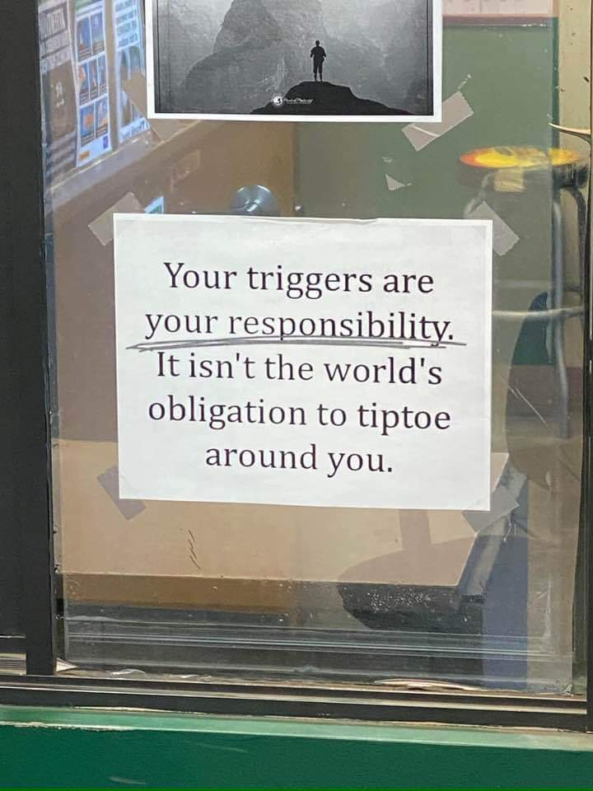

Slide 3
Objective
This training will examine ways to recognize when we are using methods that are clearly NOT working (as evidenced by “lack of compliance,” “resistance,” or some other type of “discord”) and how is in concert with ASAM and what are effective steps to take when this has been identified.
Notes:
Judgement and shame
Pejorative language – failed to comply, AMA or AFA
Resistance – really only one type of discord (traps and pit falls i.e. MI)
ASAM matching levels of care based on client want and clinical needs

Slide 5
What’s working or not…
Notes:
Is the client not getting it or are we the ones who are not getting it – who’s fault is it and who needs to change to make it better
Are you using facts and science to drive treatment / care
On size fits all – program recommendations vs client centered recommendations
Trends / fads – workouts, AI, tik tok trends (depersonalization / derealization etc)
Self diagnosing, online screening tests, over use of psychology terms

Slide 7
When EBP is not…
Evidence based practice / medicine, as it is currently practiced, is far from perfect.
Financial interests bias scientific results to the point that they are often unusable.
Single answers from (frequently flawed) meta-analyses are often treated as infallible and translated into thoughtless guidelines and core measures.

Slide 8
Research to practice
A gap exists between textbook descriptions of EBP and its general practice.
Difficult theoretical and philosophical questions about how to apply generalized results from clinical trials to individual patients.
This does not mean go rouge! EBP may still be good (when done well)
https://first10em.com/ebmisbest/
Notes:
Hand picked, closed group trials don’t translate to general practice with vary different factors

Slide 9
Mandated Clients
Consequences –was the behavior caused by addiction and/or mental illness? Is the person best served by treatment rather than punishment, then clinicians provide treatment not custody and incarceration.
The obligation of clinicians is to ensure a person adheres to treatment; not to enforce consequences and compliance with court orders
davidmeelee.com
Notes:
It is within criminal justice’s mission to ensure that offenders take the consequences of their illegal behavior.

Slide 10
Still mandated
Compliance – court’s orders; rules and regulations. Criminal justice personnel expect compliance.
Clinicians are providing treatment where the focus is not on compliance to court orders. The focus is on whether there is a disorder needing treatment; and if there is, the expectation is for adherence to treatment, not compliance with “doing time” in a treatment place.
davidmeelee.com

Slide 11
Yup still mandated
Control –courts aim to control, if not eliminate, illegal acts that threaten the public.
The only time clinicians are required to control a client is if they are in imminent danger of harm to self or others.
davidmeelee.com
Notes:
While control is appropriate for the courts, clinicians and treatment programs are focused on collaborative treatment and attracting people into recovery.
Otherwise, as soon as that imminent danger is stabilized, treatment resumes collaboration and client empowerment, not consequences, compliance and control.

Slide 12
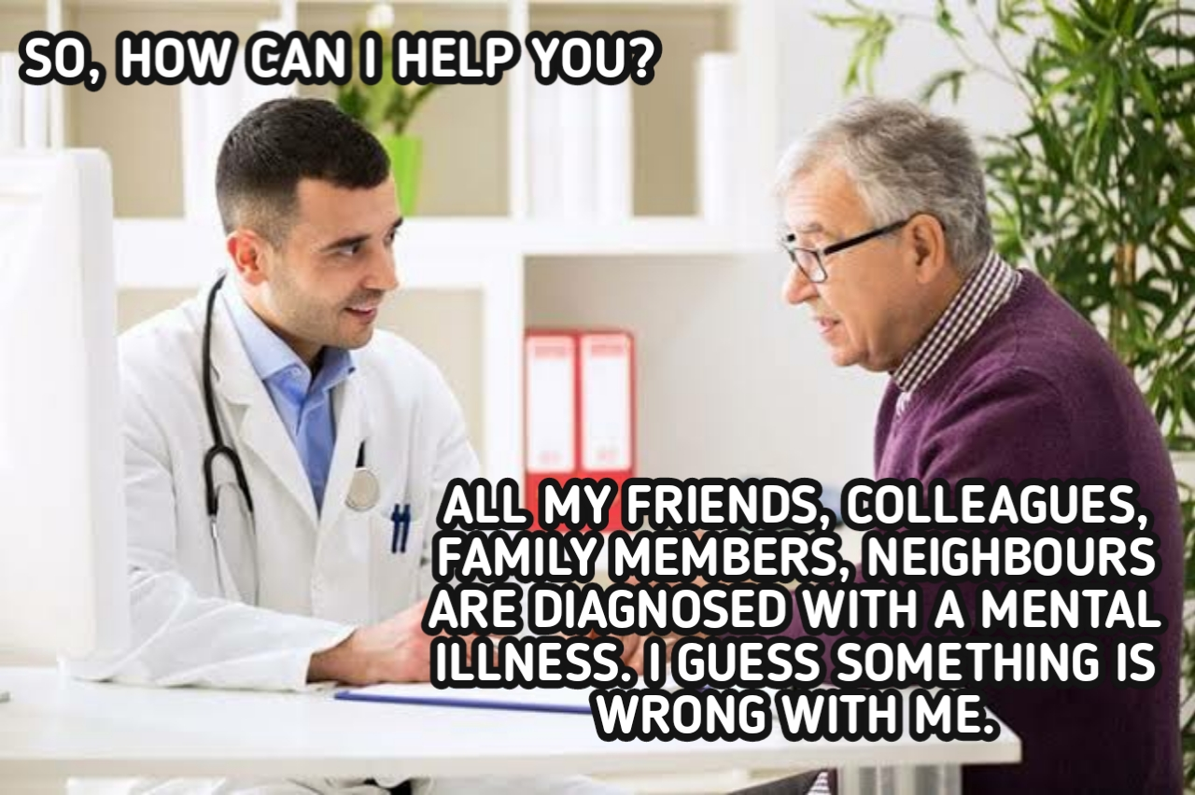

Slide 13
Objective
This training will explore ways to hold compassionate yet confrontational conversations if we find ourselves working in places that advance “cookie cutter” approaches that do not meet the various needs of individuals we serve or in situations where we are being asked to fill beds or pick one funding source over another based on pay rates etc.
Notes:
Bad actors – look good, sounds good, still may not be good
Heads in beds controversy
Choosing trendy approaches or approaches mandated by funder
Saying they are holistic when they simply offer yoga
Saying a program offers something i.e. DBT or EMDR / trauma services

Slide 15
Compassionate confrontation
Notes:
How do we challenge supervisors, admin, agency policy
Example poor supervision – door is always open or heavy on the admin vs clinical

Slide 17
Free will vs Determinism
debate is concerned with the issue of whether we are in control of our behavior or whether the way we behave is a result of external factors like the environment or genetics.
Notes:
Biblical debates
Skinner
Learned

Slide 19
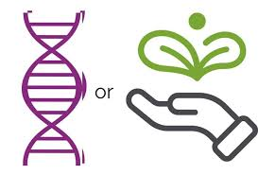
Nature vs Nurture
debate is concerned with whether our behaviors are shaped by our biology, aka, nature (genes, brain structure etc.) or whether it's the result of our upbringing (nurture).
Notes:
Addiction is a disease or is it learned / conditioned – Pavlov

Slide 20
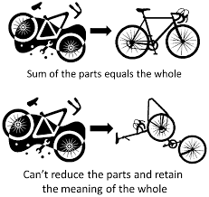
Reductionism vs Holism
debates whether we should break down concepts like people’s behavior into smaller parts to understand it, or whether we should always look at the big picture.
Notes:
Habits, i.e. dog training, child toilet training
IFS systems work parts of our selves that actually promote fragmentation and splitting further – tick toc trends

Slide 21
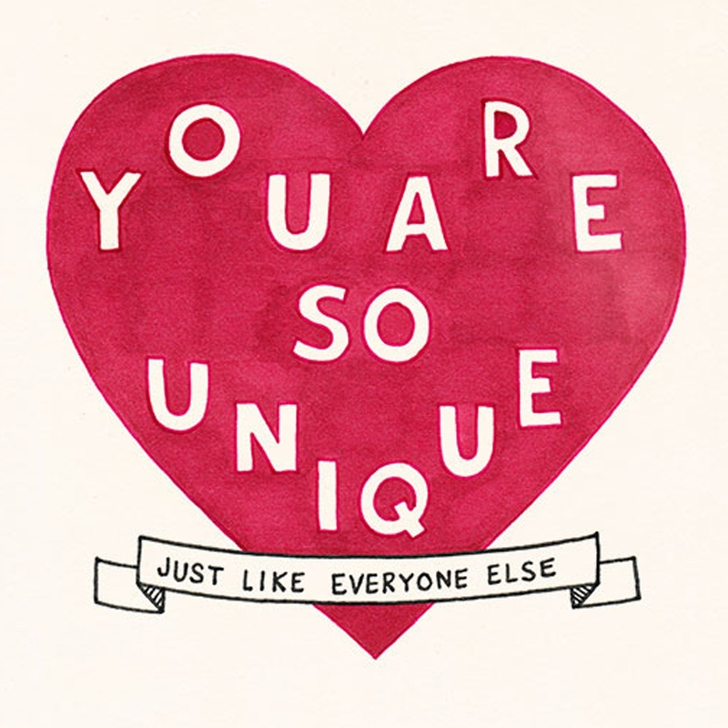
Idiographic vs nomothetic
debates idiographic approach stresses the uniqueness of each individual, while the nomothetic approach compares individuals against general and shared concepts.
Notes:
Individualistic vs collective culture
Jungian concept of collective unconscious
Multigenerational trauma – passed through cellular memories and or genetics

Slide 22
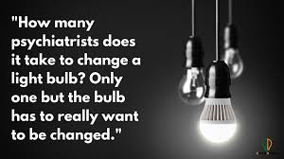

Slide 23
Objective
This training will evaluate our limited ability to impact individual behavior and the notion we cannot help everyone. Sometimes, the answer we will get regarding our intervention is NO so what does this mean to us in a practical sense, based on good clinical practice and what the client wants and needs.
Notes:
Do we really impact change or do they change when they are ready
What really causes a person to change
Clinical anxiety
Legal vs ethical
Suicidality

Slide 24
No means NO!
Notes:
How do we respect when someone says no and we know they may go use again and die

Slide 26
Autonomy over shame
In developmental psychology and moral, political, and bioethical philosophy, autonomy is the capacity to make an informed, uncoerced decision.
Ethics apply! Do your morals? How about the difference in your pathways?
Notes:
Forced or coerced treatment – cash for kids Luzerne Co
Consent under the influence
Get paperwork resigned

Slide 27
Notes:
https://youtu.be/oQbei5JGiT8?si=v5_Px0nJ0mRNEVMf

Slide 28
Do no harm!
Blackmail, coercion or intimidation are forms of psychological harm and can be crimes.
Psychological harm can also include name calling, threats, and harassment.
Is there ever a time to do harm?
Notes:
Several movies out recently about terrible treatment places from the 80/s 90/s – what have we learned?
Threatening someone to get them into treatment is manipulation – family will cut off, telling probation / parole, reporting to CYS
“first, do no harm” invoked as part of a balanced medical discussion. The phrase is almost exclusively used as an inane rhetorical device; as a way to obfuscate intelligent conversation. (If we were willing to engage in intelligent conversation, we wouldn’t need to parrot thoughtless slogans.)

Slide 29
TRIGGER WARNING

Slide 30
The past is coming back to haunt some folks
Lots of documentaries and movies about past abuse programs ….. Why now?
Notes:
How is the old TC model any different
Cash for kids
Wilderness program
The program
Conversion camps
Current lawsuits in PA

Slide 31
Why do we follow hurtful trends
When looking at trends online, it can be essential to know how to tell the difference between scientific facts and “life hacks” people have made up for views.
Promoted by untrained / unprofessional / lacking research
Untrue / unsafe / never goes away….. Even if the post is taken down or recanted
Why Following Wellness Trends Can Be Harmful To Mental Health: 2023 Trends And Impacts | BetterHelp
Notes:
Follow the dollar – who paid for it / sponsored it
BORG black out rage gallon
Vaginal rejuvenation
Weigh loss, body image, daily food videos, dry pre workout

Slide 32
What do we do now….
Having thoughts about the work you do?
Or where you work?
SUPERVISION!!!!!! Seek supervision ☺

Slide 34
Thank you ☺ drmartha@empowerthemind.org

