Slide 1
Marijuana and the Current State of the Union:
Let’s Get in the Weeds…
Eric J. Webber, MA, CADC and
Eric Rodriguez, LMSW, CAADC
Presenting for the 2024 Annual PCB Conference

Slide 2
Objectives
Be able to identify the various levels or cannabis availability in the US
Be able to define and describe addiction as a physiological brain-based disease
Identify various ways how cannabis affects mental and physical performance
Identify various ethical and legal considerations of clients using cannabis

Slide 3
Prelude: Conference Etiquette
What did you learn in Kindergarten?
  Do NOT talk out of turn, do not talk out loud when others are talking
  Do NOT have side bar conversations (I will call you out on it and not apologize)
  Raise your hand if you have a question
  When asking a question, do not prelude with a story
  Respect others
  Turn off your cell phone – because if it rings, I WILL ANSWER IT AND YOUR LIFE WILL CHANGE COURSE….

Slide 4
So… Let’s Get in the Weeds

Slide 5
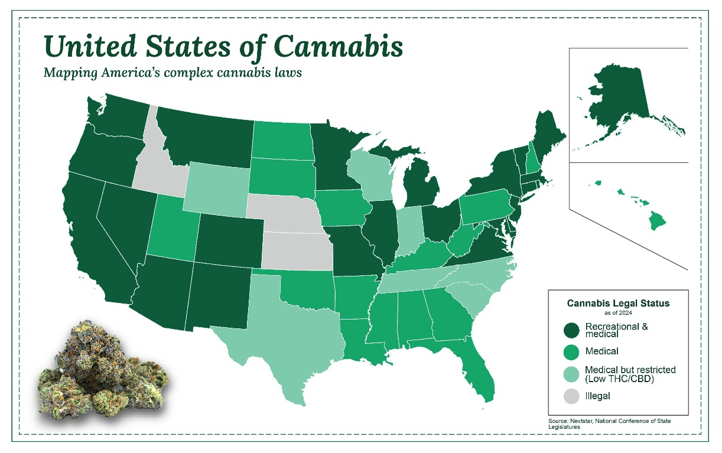
Cannabis State of the Union (as of Winter 2024)
Federal
  Continues to be classified as a Schedule I controlled substance by the Federal government
State to State
  Fully legal in 24 states
  Medical Use in 38 states
  Fully illegal in 4 states (Idaho, Wyoming, Kansas, S. Carolina)
  Varied forms of availability / legality in other 25 states

Slide 6
Attitudes About Legalization
2021 Pew Research poll showed 91% of Americans believe cannabis should be legalized to some degree
  31% for medical use
  60% for both medical and recreational use
An April 2022 poll showed 66% percent of respondents believe recreational marijuana should be legal

Slide 7
Medicalization
Marijuana promoted as a treatment for epilepsy, chronic pain, nausea, mood disorders, glaucoma, Crohn’s disease, ALS, MS/spasms, OUD
  Lack independent research
  No FDA review
1996 California becomes the first state to approve medical marijuana
2018 FDA approves Epidiolex (cannabidiol) [CBD] oral solution for severe, rare forms of epilepsy; 3 synthetic cannabis-related drug products follow
Almost three decades of advocacy and marketing rebranded marijuana as a health product
Americans think healthy = safe

Slide 8

The Magic Elixir
Haven't we gone down this road before?

Slide 9


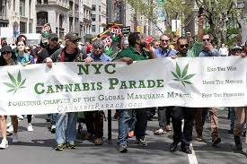
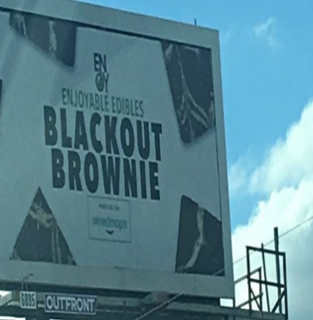
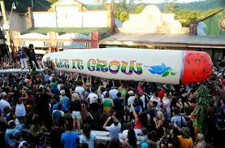
It’s everywhere…
Notes:
Account for cultural norms – what are our clients seeing?
It’s hard to escape mentions of it especially in legalized states where there are pot shops all over, billboards advertising, parades in celebration. And of course there has been an increase in mentions of marijuana in popular music, movies and TV shows and all over social media with #cannabis, #710, #420. .

Slide 10
Marijuana, Cannabis, Mary Jane? And Cannabis Availability

Slide 11
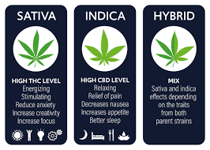
Marijuana Basics
It’s really Cannabis (Genus)
There are different species of the plant
There many cannabinoids found in the plant. Perhaps <60.
  Delta 9
  Delta 8
  Delta 10
  CBD
To change image, press ‘DELETE’ and select image icon to findyour image.

Slide 12
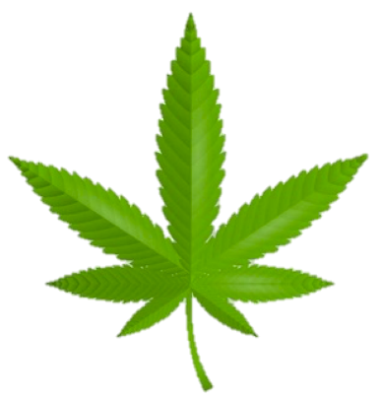
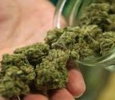
Cannabis
Basics
Legally, Industrial Hemp is a strain of Cannabis that contains .03 THC or less
Marijuana (USA) is Cannabis that contains .03 THC or more
Cannabis
It’s the name and species of the plant
Cannabinoids: The chemical/substance, regardless of structure or origin.
These join the Cannabinoid receptors in our brain.
Species
Indica: Greater CBD content
Sativa: Greater THC content
Ruderalis: Lower CBD & THC, often used in hybrids
Hybrids: Altered and engineered
There are hundred of
chemicals in Cannabis
The most common discussed:
THC: Delta-9 Tetrahydrocannabinol
CBD: Cannabidiol
“Strains”
Notes:
What is it

Slide 13
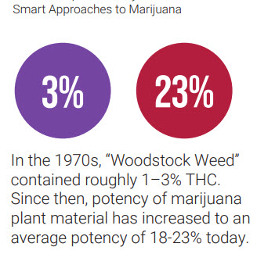
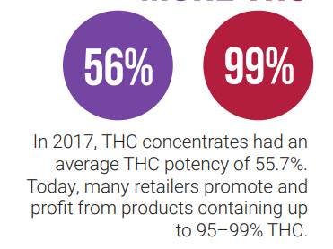
Agent of Mind Alteration
THC: percentages (MJ) vs milligrams (edibles)
Prior to 1990s, <2%
In the 1990s, grew to 4%
Presently, ranging from 15-30%
THC and the brain / body
THC is lipophilic

Slide 14
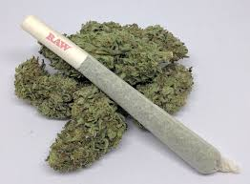
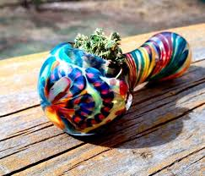
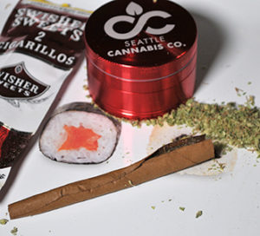
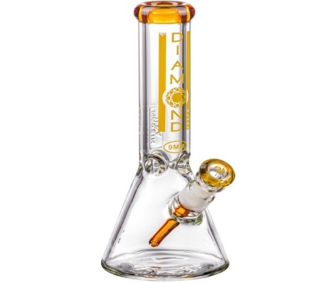
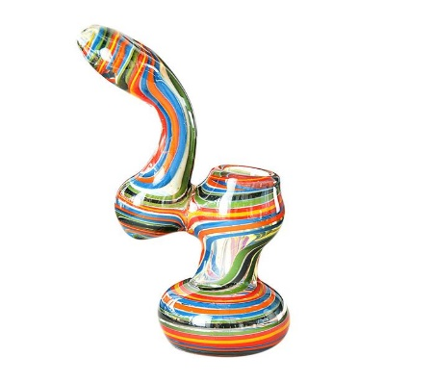
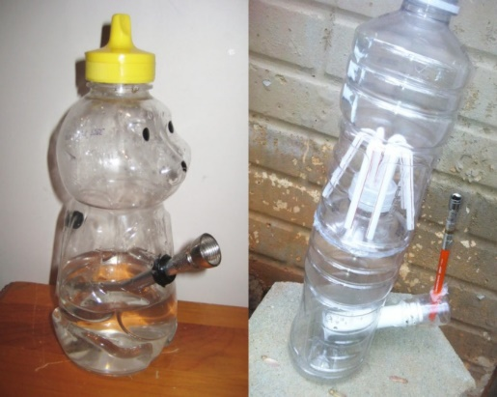
Methods of Consumption: Smoked
Flower Marijuana Average THC Potency ~ 17%
Joint
Bowl
Blunt
Bong
Bubbler
Homemade creations
Notes:
As the cannabis industry has become competitive, growers are looking to make a name for themselves and one of the ways they have done this is by trying to produce plants that will lead to a more intense high. By hybriding seeds and growing them in certain conditions, with certain lighting, they have succeeded in completely changing cannabis. In the 70s the marijuana plants had an average THC content of about 0.5%, in the 90’s it was about 4%, now, the average is around 17% with the ability to get strains that are well into the 20+%. This change is why we are seeing an increase in people having very adverse reactions to marijuana and also developing cannabis use disorders that require treatment. (Dr. Staci Gruber, Professor of Psychiatry, Harvard Medical School: • “Right now, the average potency across the nation from government-seized products is about 17 percent, that’s contrasted to about just under 4 percent in 1995.”)
Let’s explore some of the different ways that cannabis can be consumed. The first is through smoking it. There are many options for smoking the actual cannabis buds or flowers. Through a joint, bowl, blunt, bong, bubbler and various homemade creations. You can smoke weed out of an apple. The possibilities are endless and users love to experiment with all the different methods. Glasswear like bowls and bongs are actually regulated as tobacco devices, so until the Federal age of 21 for tobacco was put into place, you only needed to be 18 to go to a headshop and purchase glass. It is also incredibly easy to order these things online underage. They can be delivered straight to your house or to a UPS drop location. There is one at my local grocery store.
Inhaling smoke of any kind, whether it is from tobacco, weed or another substance is bad for lung health. It is an irritant and users will often cough when inhaling and then claim it isn’t bad for the lungs.

Slide 15
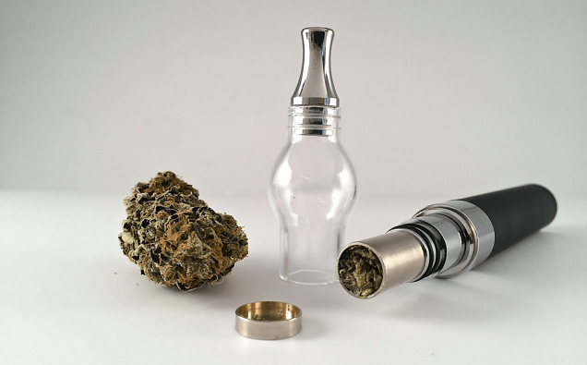
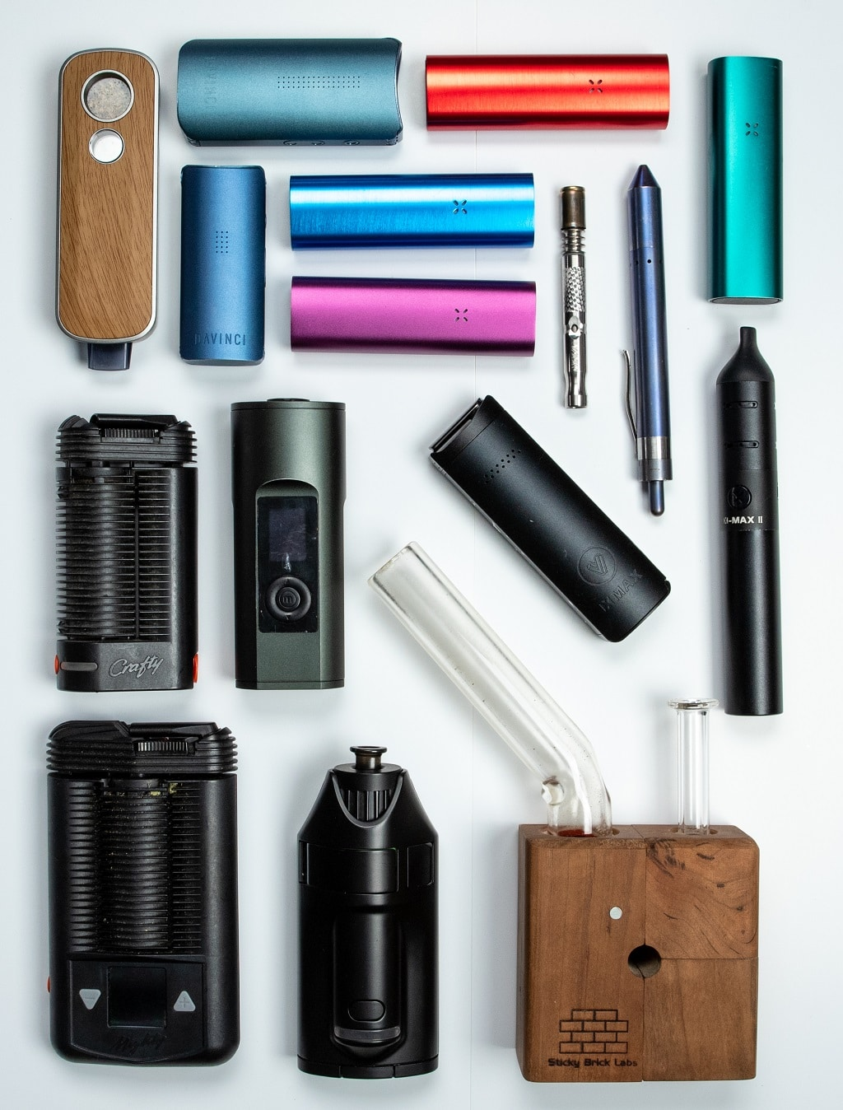
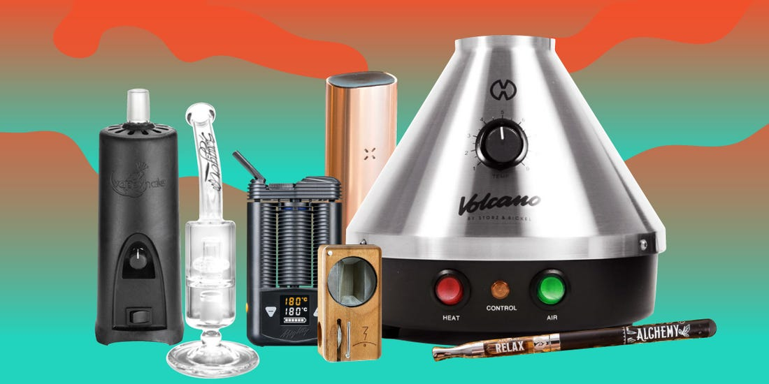
Methods of Consumption: Vaporized
Dry Herb/Flower Vapes
Notes:
In addition to smoking marijuana, the dry herb/flowers can also be used in various vaporizer devices. These devices heat the cannabis to a certain temperature, usually between 330-370 degrees F. Many think it is healthier because the cannabis is heated instead of burned. As with most things related to marijuana, there is little research so I can’t confirm if this is the case of not. As with most vaping devices, these dry herb vapes contain a battery and are rechargeable.

Slide 16
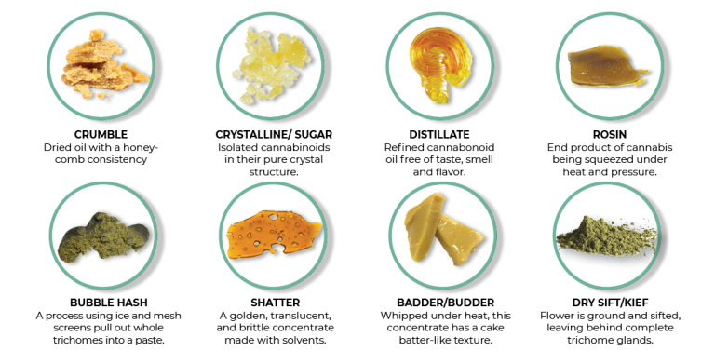
Methods of Consumption: Vaporized
Concentrates: Average THC Potency ~ 60-99%
Notes:
Vaping concentrates is not new but is certainly less well known by the general public who aren’t into marijuana. There is a process you can do to cannabis plant using heat and solvents like butane, CO2, propane or ethanol to extract potent concentrates of THC. The different forms can look like wax, more like brittle pieces called shatter and like the other forms on this slide. With these concentrates, we are talking about THC potency between 60-90% on average. Anyone using these is seriously drugging their brain.

Slide 17
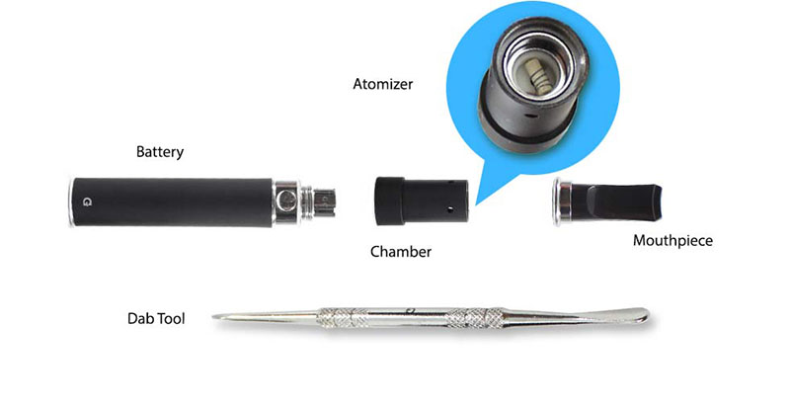
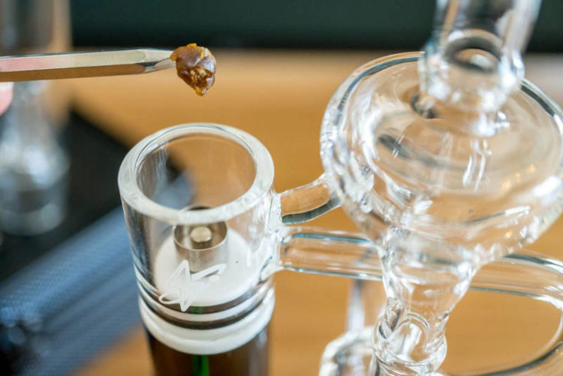
Methods of Consumption: Vaporized
Wax/Dab Pens
Dab Rig
Notes:
These concentrates are then put into vaping devices referred to as dab or wax pens and heated to about 350 degrees and inhaled. This would not have as strong an odor as traditional dry herb does, but it still has a smell to it that is hard to define. There are also glass devices called rigs that can be used to vape the dabs out of.

Slide 18
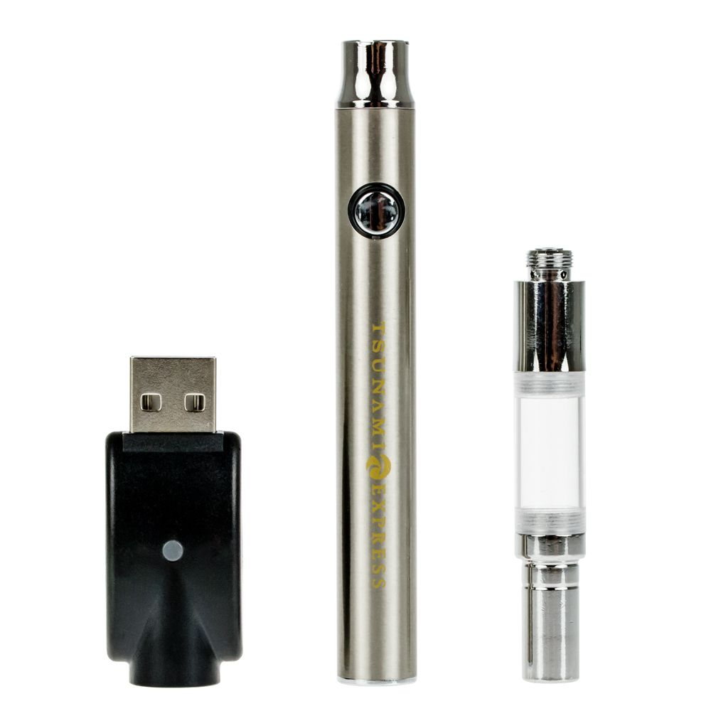
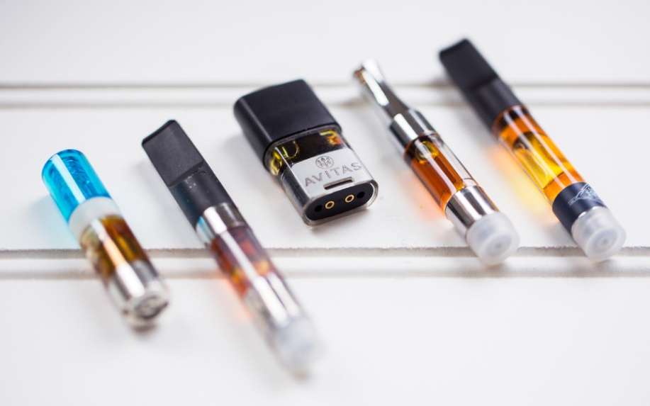
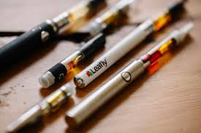
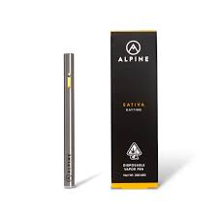
Methods of Consumption: Vaporized
THC Oil Pens: Average THC Potency ~ 15-90+%
Charger
Battery
Cartridge
“Cart”
Notes:
Another popular and incredibly easy method of consuming marijuana involves vaporizing pre-filled cartridges of THC oil. Oils are another form of concentrate with potency ranging anywhere from 15% to over 90%. Pictured are examples of rechargeable battery devices as well as disposable ones. Due to the difficulty of obtaining true THC oil because of strict regulations in the industry, some manufactures have been using thickening agents such as vitamin e acetate to stretch their supply. This is the main culprit behind the 2,807 hospitalizations and 68 deaths to date from the lung injury termed EVALI by the CDC.

Slide 19
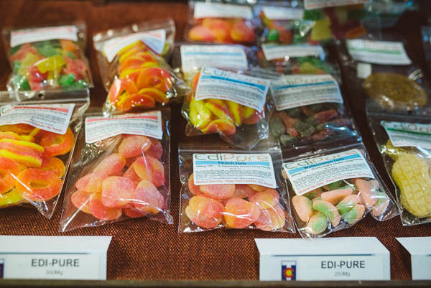
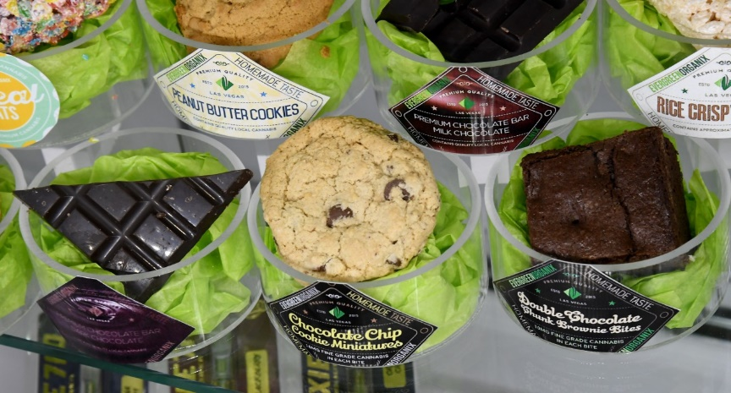
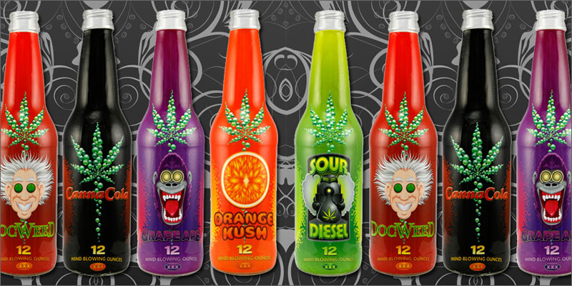
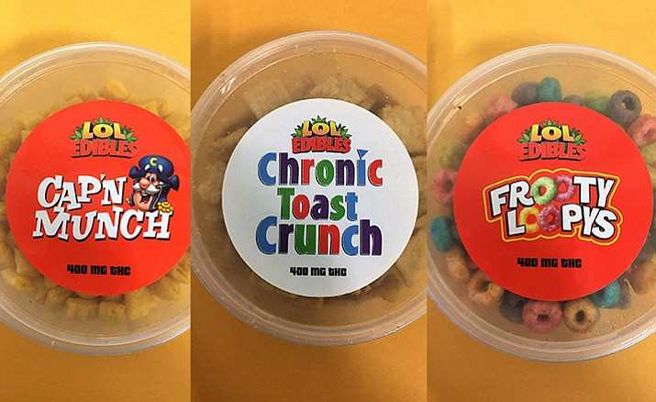
Methods of Consumption: Eaten/Edibles
Notes:
Marijuana can also be baked into many goods and as legalization has spread, the options for edibles have greatly expanded. You can get drinks, candies, cookies, and just about anything else with THC in it. Both edibles and smoking bring marijuana into your body, but it doesn’t go to the same places. When you smoke, you inhale THC into your lungs before the effects on other body parts are felt. With edibles, the THC goes into your stomach before being rerouted into your liver and other organs. Typically, less THC is consumed from edibles than from smoking, but it can stay inside you much longer.
When someone smokes marijuana, they feel the effects fairly quickly. They can stop when they have their desired effect. However, with edibles, the feeling is far more delayed. It can take up to three hours for edibles to be felt. Someone might expect that an edible marijuana product, like a brownie, is supposed to hit them immediately. When that doesn’t happen, they might over-correct by eating more than their body can handle. When the high does set in, it can be an extremely uncomfortable situation. They might feel like they’re on the verge of a heart attack. There could also be symptoms of a panic attack, such as shallow, rapid breathing. You are more likely to end up in the emergency room because of edibles.

Slide 20
Direct Consequences of Access
Legalizing recreational cannabis for adult use is associated with increases in pediatric cannabis poisonings (NIH).
Young children with cannabis poisoning frequently present with high-acuity conditions, including a decreased level of consciousness, respiratory depression, and seizures (NIH).
Pittsburgh Poison Center of UPMC for marijuana exposure in children younger than 13 increased from 25 in 2019 to 86 in 2022 with 23% needing acute hospitalization (UPMC).
Straining an already overextended system.

Slide 21
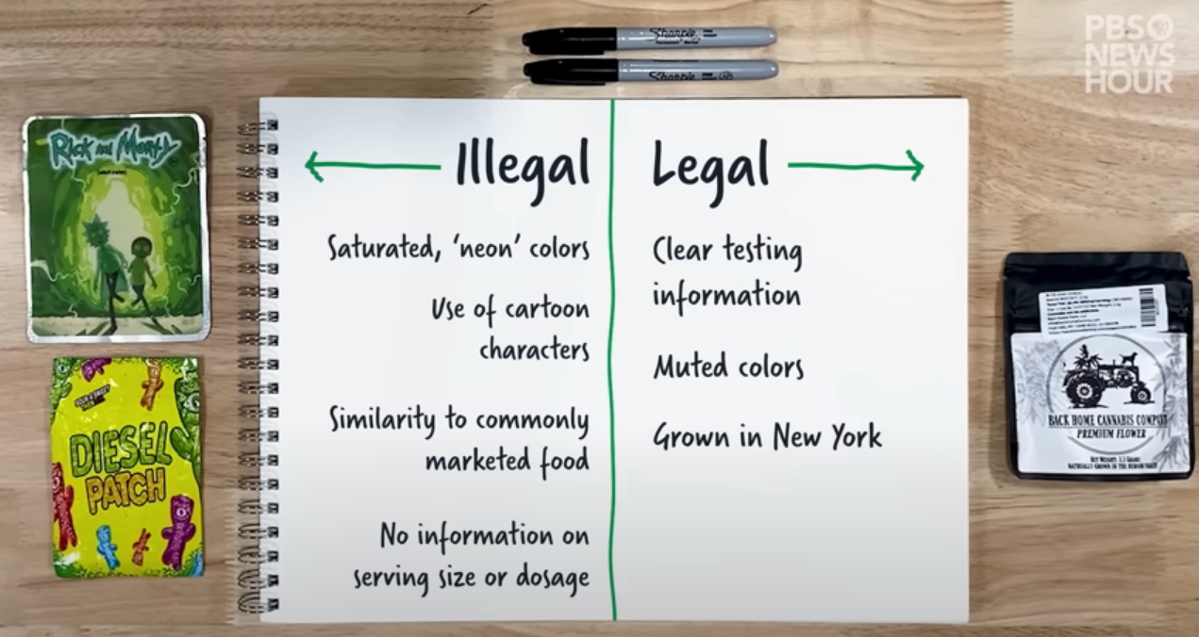
Legal vs. illegal dispensaries

Slide 22

What about CBD?
Cannabidiol is sometimes touted as a magical elixir
Potentially promising treatment for many ailments
More research is needed
Largely unregulated; purity levels are in question
May interact with medications
Talk to your doctor
Notes:
https://health.usnews.com/wellness/articles/how-to-buy-cbd
Many people these days are curious about CBD. It is everywhere and being advertised as a treatment for literally everything from anxiety, to insomnia, to inflammation to joint pain to acne and the list goes on and on. There are even CBD products for your pets. You can get CBD infused lattes and facials. It is the wellness product of the moment.
CBD is short for Cannabidiol and is another chemical in the cannabis plant along with THC. THC is psychoactive, CBD is not. It won’t get you high.
So far, scientific research has found that CBD can help to treat two types of seizure disorders in children, when it’s in a medication (called Epidiolex) that’s been approved by the U.S. Food and Drug Administration. Scientists are studying whether CBD might be effective in treating other conditions, including anxiety, sleep, pain, and drug and alcohol use disorders. For now, it’s too early to say. CBD products—like lotion, bath oil, or honey—haven’t proven to be effective medical treatments for any conditions.
Since this is a free for all at the moment, you really need to be careful about purchasing these products without doing research. Some have been found to contain pesticides and other impurities. Some have so little CBD in them that they aren’t going to do anything and you are wasting money. Please do your research, talk to your doctor, especially if you are on medications as CBD could impact how those meds work.

Slide 23
Cannabinoid Basics
Cannabinoids are compounds found in the cannabis plant that interact with our endocannabinoid system, our bodies internal communication system.
  The most notable cannabinoid is Tetrahydrocannabinol, the primary intoxicating compound in cannabis
  Similar to opioids, cannabinoids produce their effects by interacting with specific receptors located within different parts of our central nervous systems.
  Simply put, cannabinoids regulate how cells communicate.

Slide 24
Physiological Brain Disease

Slide 25
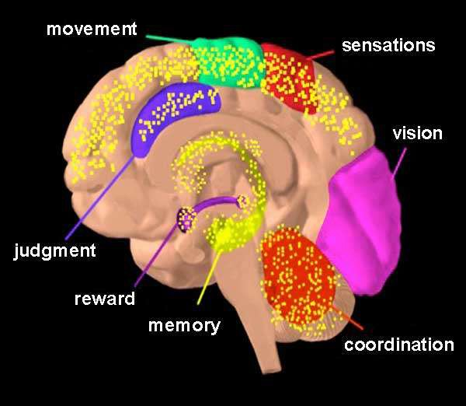
THC Basics
The psychoactive drug in the cannabis plant that causes the “high”
The plant has been engineered to have more THC than ever before
THC lingers in the brain and body
It is a mixed action drug with properties of stimulants, depressants and hallucinogens
NIDA established 5 mg of THC as standard for Research – average THC in commercially available products are greater than 20%
THC acts on numerous areas in the brain (in yellow). NIDA

Slide 26
Endocannabinoid System (ECS)
Explaining the role of the endocannabinoid system in regulating various physiological processes and how cannabis interacts with this system.
  Receptors: The ECS primarily involves two types of receptors: CB1 (central nervous system) and CB2 (peripheral nervous system).
  Endocannabinoids: These are endogenous cannabinoids produced naturally within the body.
  Enzymes: Enzymes are responsible for synthesizing and degrading endocannabinoids.
  Functions: The ECS plays a crucial role in regulating various physiological processes, including mood, appetite, pain sensation, memory, and inflammation.
  Modulation of neurotransmitter release: The ECS regulates neurotransmitter release in the brain, including the release of gamma-aminobutyric acid (GABA) and glutamate.
  Pharmacological effects of cannabinoids: Cannabinoids interact with the ECS receptors, mimicking or modulating the effects of endocannabinoids.

Slide 27
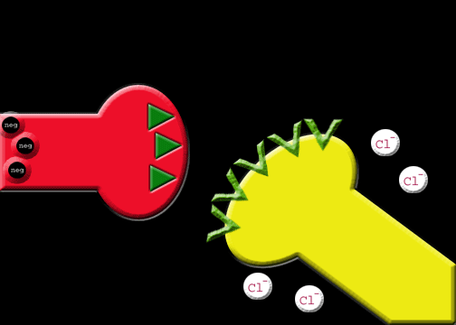
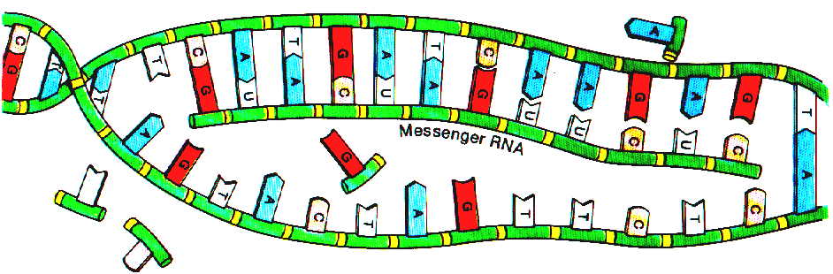
Neurotransmitters
New desires
cravings
Receptors
Activates Genes
New Proteins
New memories
Learning
Sets off new chemical reactions

Slide 28
Plasticity of the Brain
Brain adapts to experience
  Changes in receptors and neurotransmitters
  Changes in chemical reactions elicited by stimuli
  “Rewiring” of nerve connections
  Changes in gene expression aka epigenetics

Slide 29
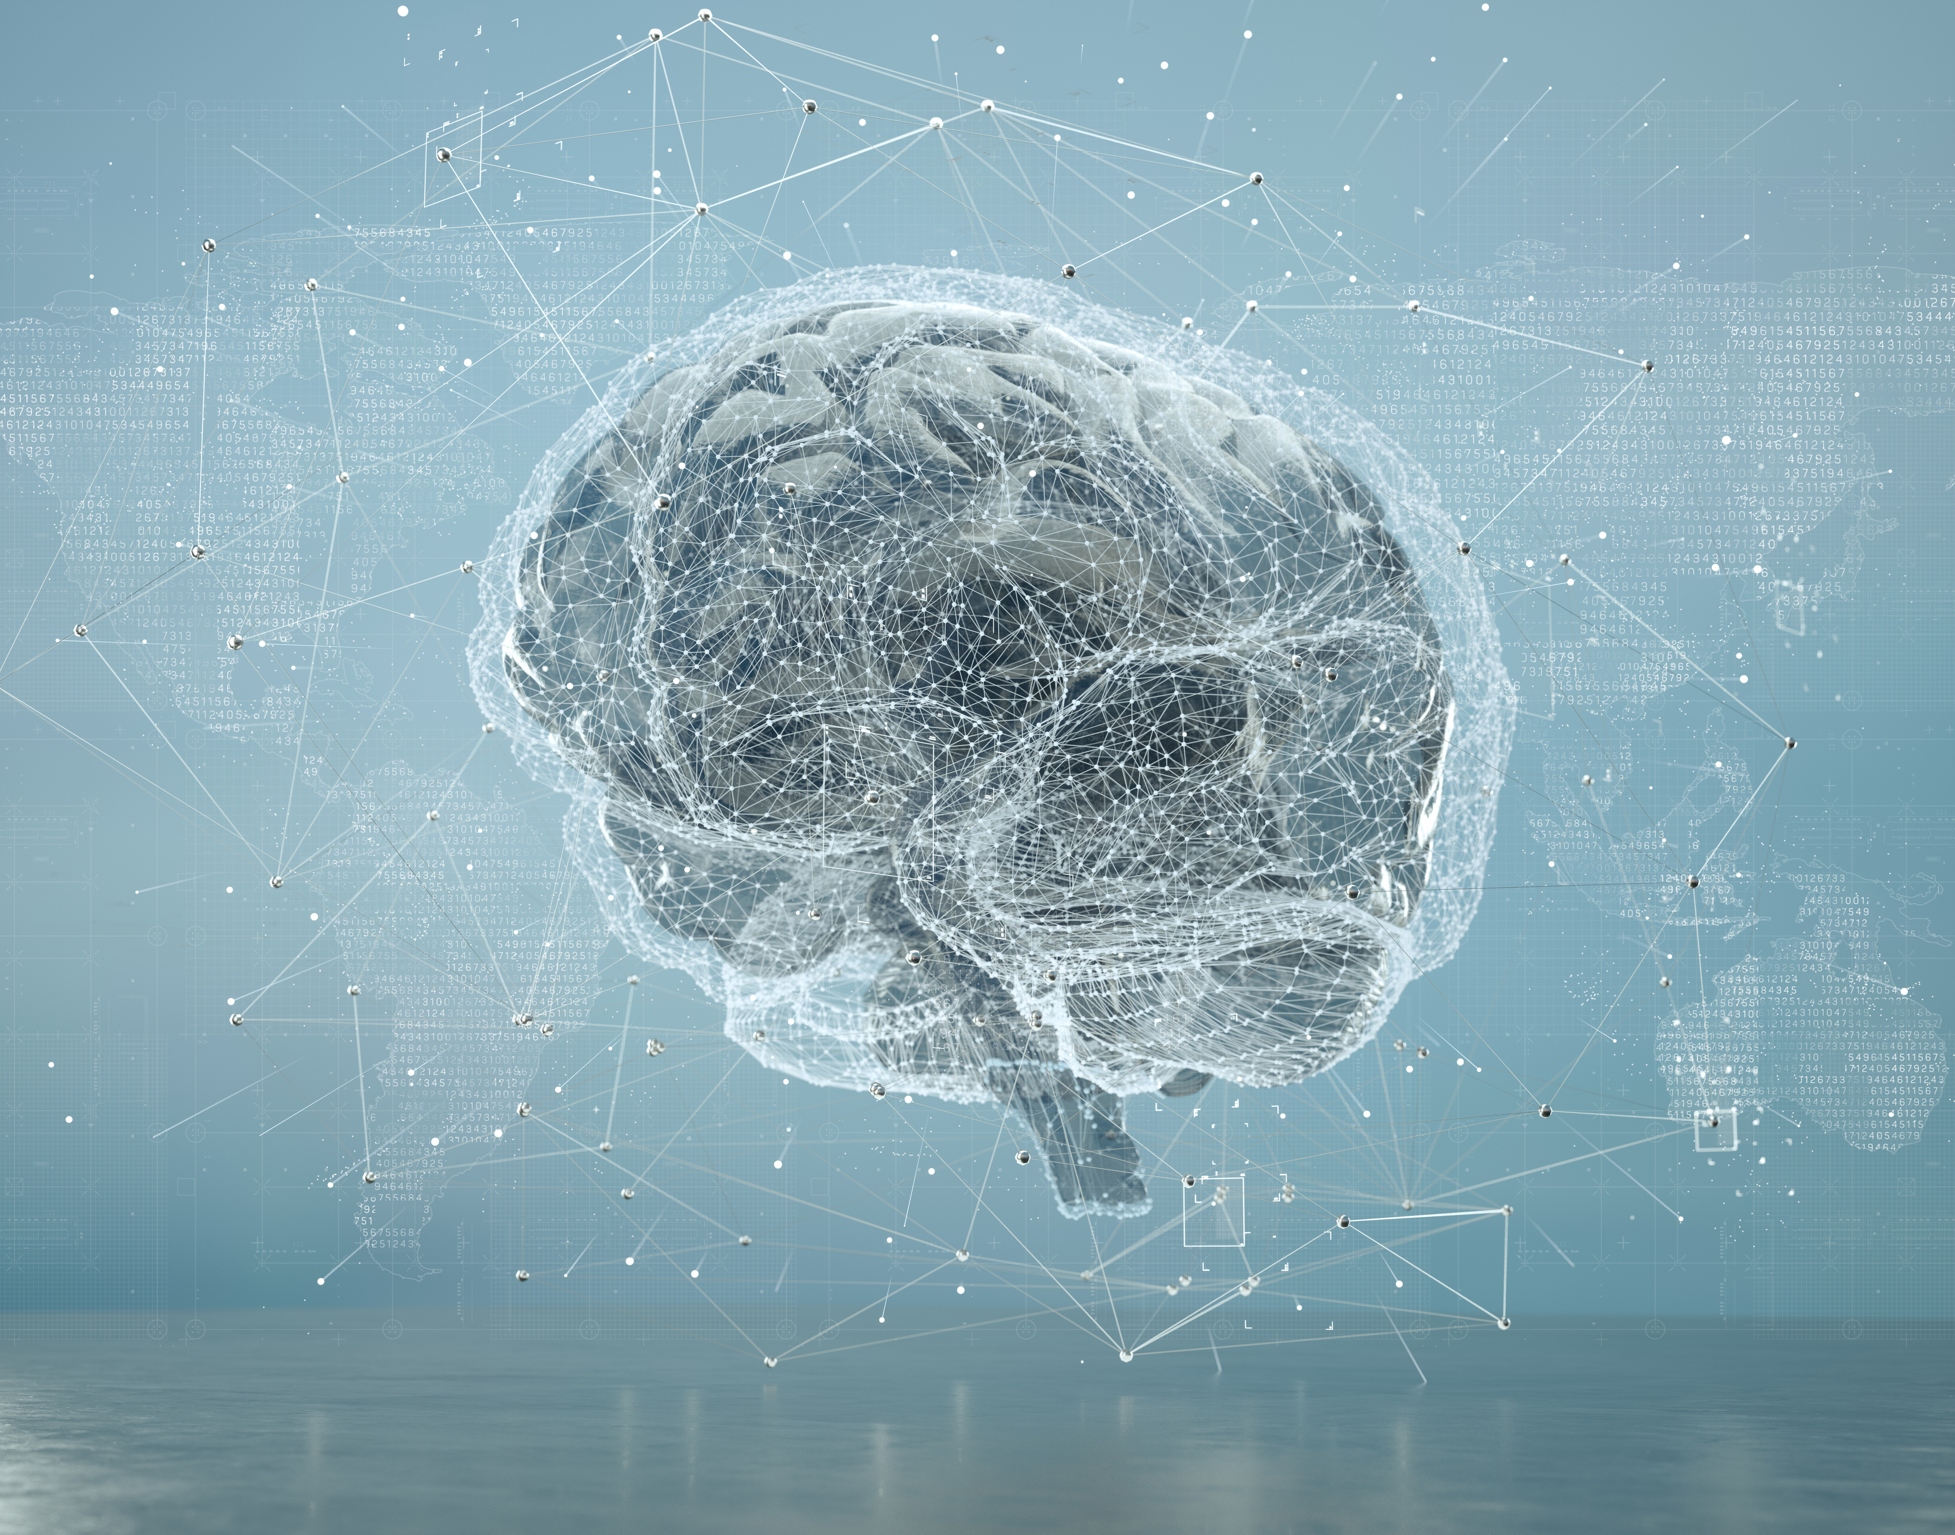
A Brain Disease
Limbic System (Survival)
  the basal ganglia (Reward), the extended amygdala (Fear), and the prefrontal cortex (Decision Making)
Effects
  Love, Affirmation, Pleasure, fight/flight, stress systems, judgement
Creates
  Behavioral Adaptation

Slide 30
Cannabis Addiction
Addiction is a stress induced, genetically mediated, primary, chronic disease of brain reward, motivation, memory and related circuitry.
Dysfunction in these circuits leads to characteristic biological, psychological, social and spiritual manifestations.
This is reflected in an individual pathologically pursuing reward and/or relief by substance use and other behaviors…

Slide 31
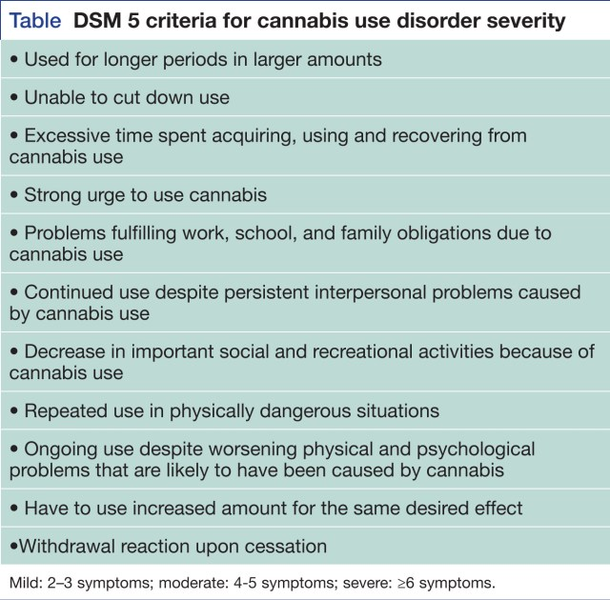

Slide 32
What We Know About Use
In 2020, SAMHSA’s National Survey on Drug Use and Health reported:
49.6 million people used marijuana it in the past year.
  Young adults aged 18 to 25 (34.5% or 11.6 million)
  Adolescents aged 12 to 17 (10.1% or 2.5 million)
14.2 million people aged 12 or older met the criteria for marijuana use disorder
  1.0 million adolescents
Worldwide:
76% rise in people entering treatment for CUD/MUD in the past 10 years reported by the European Monitoring Centre for Drugs and Drug Addiction
UN reported the proportion of people seeking treatment for cannabis addiction has risen in all regions of the world (except Africa) has increased in the past 20 year

Slide 33
Increase in Hospitalization
Study in the Annals of Internal Medicine show a three-fold increase in ER visits in Colorado for marijuana-related incidents since legalization:
  Edibles
Although edible cannabis only made up 0.32% of sales in Colorado from 2014 to 2016, 10.7% cannabis-related emergency department.
  Cardiovascular
  Psychosis

Slide 34
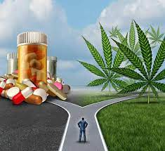
Legal Marijuana or Illegal Marijuana
Regulations and monitoring varies by states
Possible physical and mental health impacts no matter the manner of purchase
Illegal purchase increases the risk of other substances being laced into cannabis
  Is there Fentanyl in my weed?
  Cannabis OD deaths are frequently linked to polysubstance use or mental health
  Increase risks of laced cannabis

Slide 35

Drug Interactions
Alcohol and other mind-altering chemicals - Marijuana use might increase the effects of alcohol.
Anticoagulants and anti-platelet drugs, herbs and supplements - These types of drugs, herbs and supplements reduce blood clotting. Marijuana might change how the body processes them, possibly increasing the risk of bleeding.
CNS depressants - Marijuana use in combination with CNS depressants might increase the sedative effect of these drugs.
Protease inhibitors. When used with these antiviral drugs, marijuana might reduce their effectiveness.
Selective serotonin reuptake inhibitors. Mixing marijuana with this type of antidepressant might increase the risk of mania.

Slide 36
Medical Uses of Cannabis
Alzheimer's disease
Amyotrophic lateral sclerosis (ALS)
HIV/AIDS
Crohn's disease
Epilepsy and seizures
Glaucoma
Multiple sclerosis and muscle spasms
Severe and chronic pain
Severe nausea or vomiting caused by cancer treatment

Slide 37
Marijuana & Health
Distorted Perceptions/Psychosis
Anxiogenesis
Depression
Impaired Coordination
Impairment of cognition and executive function
Learning Difficulties
Impairment of Memory
Lassitude
Notes:
Anxiogenesis: the process by which new blood vessels form, allowing the delivery of oxygen and nutrients to the body's tissues. It is a vital function, required for growth and development as well as the healing of wounds.
Lassitude: lack of energy

Slide 38
Risks associated with THC
Problems with memory, learning & problem-solving
Distorted perception
Apathy
Increased risk of mental illness
Increased risk of developing SUD
Unpredictability, (even hospitalization) especially with edibles
CHS: Cannabinoid Hyperemesis Syndrome

Slide 39
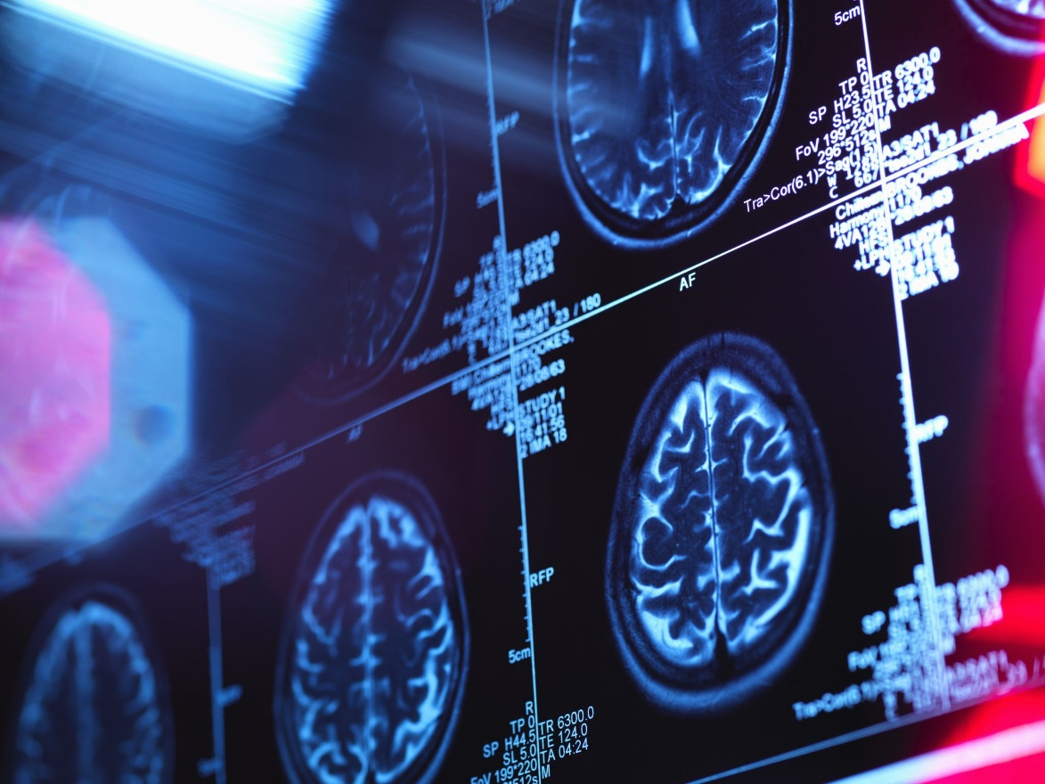
Marijuana Makes All Mental Health Symptoms Worse
Marijuana use is associated with increase in:
  Anxiety
  Depression
  Paranoia
Even one-time marijuana use can cause a psychotic break

Slide 40
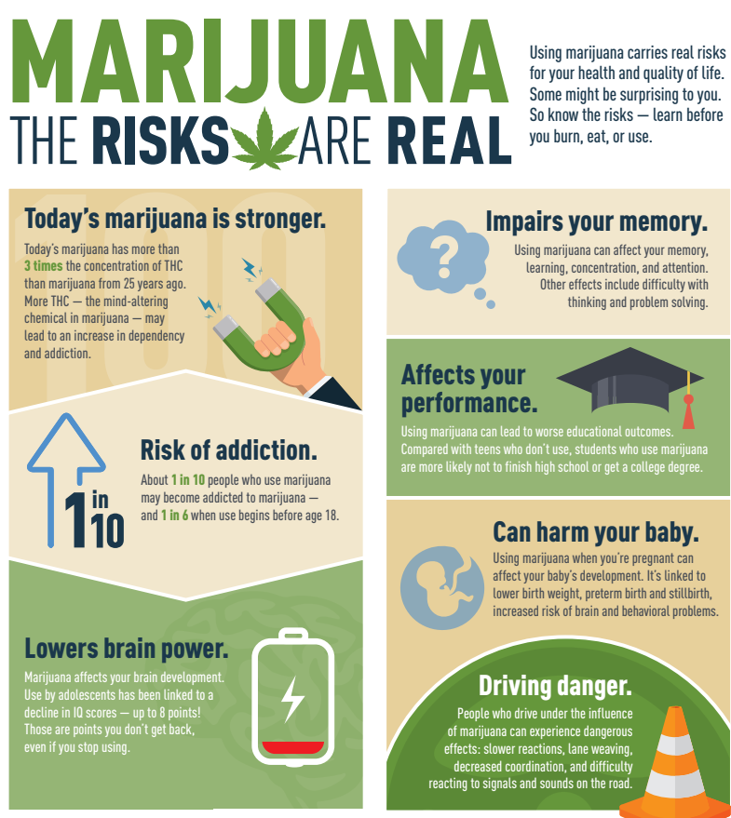
SAMHSA, 2023

Slide 41
Psychological Concerns

Slide 42
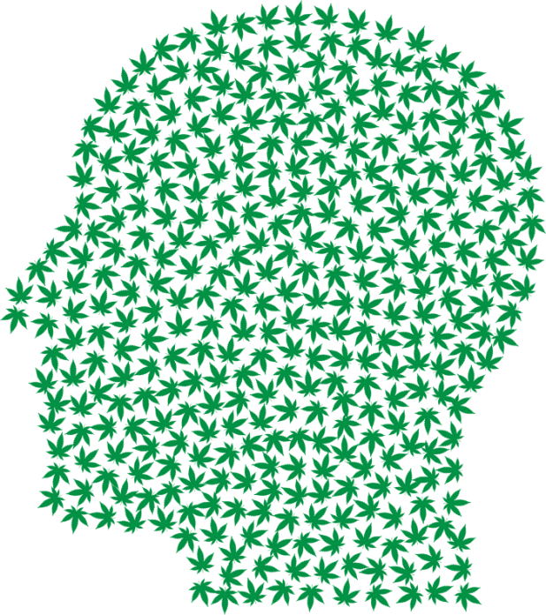
What does research tell us?
Seeing marijuana-induced psychosis on a more regular basis.
1970’s less than 1/2 % of THC; 1980’s the percentage of THC in marijuana was around 4%. As of 2018, the concentration of THC ranged from 20-25%, today above 30%; concentrates can contain 95% THC levels
Additional NIDA source: https://archives.drugabuse.gov/rise-in-marijuanas -thc-levels
Notes:
Stick with the facts

Slide 43
Stick to the Research
Marijuana does not successfully treat mood disorders.
The 2005 National Epidemiologic Survey on Alcohol and Related Conditions found every single psychiatric malady – anxiety, depression, social phobia, panic, agoraphobia – was made worse by marijuana.

Slide 44
Marijuana Exacerbates Psychiatric Issues
Marijuana can contribute to and exacerbate psychiatric issues. A 2005 study found every single psychiatric malady -- anxiety, depression, mania, social phobia, panic, agoraphobia -- was made worse by marijuana. In February 2020, JAMA Psychiatry published a longitudinal study that concluded 400,000 cases a year of depression among teens in the U.S. can be attributed to marijuana use.

Slide 45
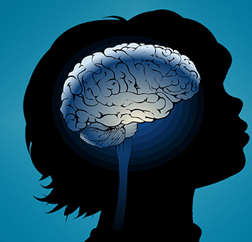
Marijuana Use can Impact Intelligence
Marijuana can impair cognitive development for those under age 25. A New Zealand study showed that long-term use is associated a change in IQ.
Marijuana can impair cognitive development for those under the age of 25. A New Zealand Study from 2019 showed that long-term use is associated with a six-point drop in IQ.

Slide 46
What We Know
Non-disordered cannabis use (NDCU) among US adolescents are associated with adverse psychosocial events
Cross-sectional study of 68,263 adolescents, NDCU was approximately 4 times more common than cannabis use disorder (CUD).
Adolescents with NDCU or CUD had increased odds of adverse psychosocial events.

Slide 47
What We Know
Teenagers who use cannabis only recreationally are two to four times more likely to develop psychiatric disorders, including depression and suicidality, than teenagers who don’t use cannabis at all. (Sultan, 2023)

Slide 48
What We Know
Young men are at the highest risk of schizophrenia linked with cannabis use disorder.
as many as 30% of cases of schizophrenia among men aged 21-30 might have been prevented by averting cannabis use disorder. (C Hjorthoj, 2023)

Slide 49
Therapeutic Implications

Slide 50
Risk Factors for Addiction
Starting use at a young age
Psychological
Factors
Environmental Factors
Genetic Predisposition
Notes:
Some teens who use are at greater risk for developing the chronic, uncurable brain disease of addiction. The following factors might make one child more vulnerable than another.
Genetic predisposition- 50% of a person’s risk is genetic. Does addiction run in your family? You should be honest with your child if it does.
Psychological factors (e.g., stress, personality traits like high impulsivity or sensation seeking, depression, anxiety, eating disorders, personality and other psychiatric disorders)
Environmental influences (e.g., exposure to physical, sexual, or emotional abuse or trauma, substance use or addiction in the family or among peers, access to an addictive substance; exposure to popular culture references that encourage substance use)
Starting alcohol, nicotine or other drug use at an early age
ACE’s Study

Slide 51
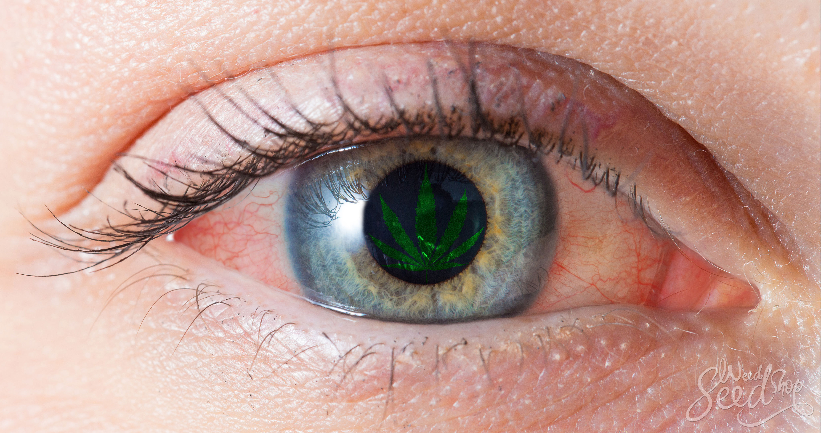


Warning Signs of Possible Marijuana Use
Physical Changes
Bloodshot eyes
Increased appetite
Slowed reaction time
Dry mouth
Impaired coordination
Sleepiness
Odor of marijuana
Behavior and
Attitude Changes
Withdrawing from family
Secretiveness and lying
Abrupt change in friends
Apathetic
Needing more $
Defensive
Nervous or paranoid behavior
Productivity Changes
Decline in school performance
Dropping activities
Less motivation
Memory impairment

Slide 52
What is Impairment?
Research demonstrates:
  Cannabis users experience deficits in brain activation in motor control regions that persist past acute intoxication
  Frequent cannabis users had significantly increased impairment after using cannabis with high THC concentration
  Cannabis-use-dependent neurocognitive impairments can be detected for as long as 28 days after cessation

Slide 53
Legal & Ethical Considerations

Slide 54
Legal vs. Ethical
View similar to Alcohol
So, what’s the difference?
  And does it matter?

Slide 55
Legal and Regulatory Considerations
Understanding the legal status of cannabis at the federal, state, and international levels, including laws related to medical and recreational use, cultivation, distribution, and possession.

Slide 56
Patient Empowerment and Informed Decision-Making
Empowering individuals to make informed decisions about cannabis use by providing them with accurate, evidence-based information and resources.

Slide 57
Social and Cultural Impact
Exploring the historical, cultural, and social dimensions of cannabis use, including its stigma, stereotypes, and the impact of prohibition policies on communities.

Slide 58
Treatment Considerations

Slide 59
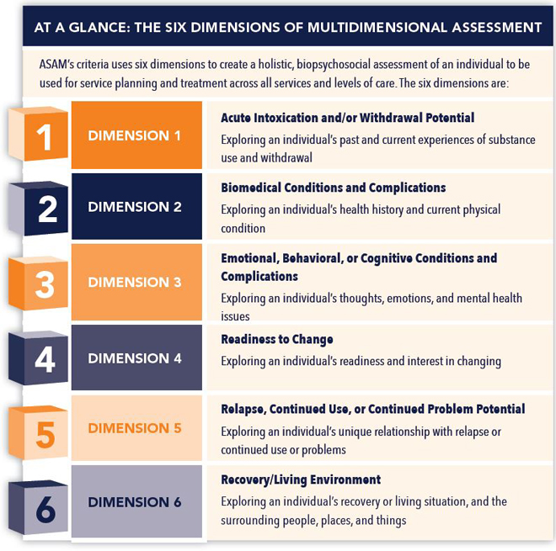
Notes:
Brief overview of the six dimensions. Will go into further detail throughout this presentation.

Slide 60
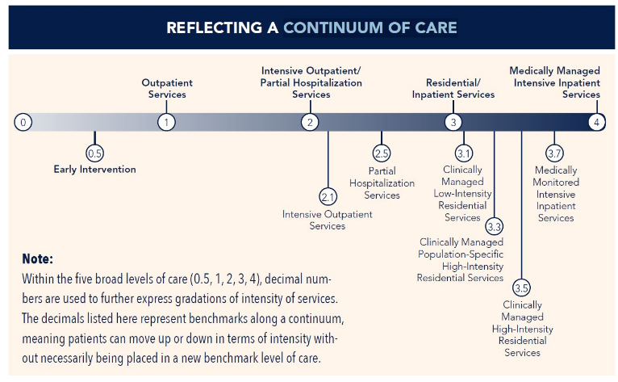
Notes:
Different levels of care based on symptoms. Give example of the severity of diabetes, heart disease, or another chronic, progressive illness and how it relates to early intervention, outpatient services, inpatient rehabilitation, inpatient ER/intensive care.

Slide 61
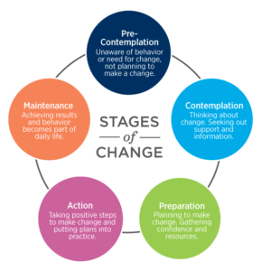
Stages of Change
-Pre-contemplation
-Contemplation
-Preparation
-Action
-Maintenance

Slide 62

The “Spirit” of MI
Collaboration vs Confrontation
Evocation vs imposing ideas
Autonomy vs authority
(Rollnick, 2023)

Slide 63

Principles of MI
Express empathy
Support self-efficacy
Roll with resistance
Develop discrepancies
To Focus on:
Assessing motivation
Identifying target behaviors
Finding change talk
(Rollnick, 2023)

