Slide 1
Big Pharma, Big Solutions
A Close Look at the Opioid Epidemic and Lessons Learned from Big Tobacco
Mike Palladini, RPh MBA
Pyramid Healthcare, Inc

Slide 2
Disclaimer
The views expressed in this presentation are those of the author and do not reflect the official policy or position of any other agency, organization, employer or company”
Thank you
Mike Palladini
palladini.michael@gmail.com

Slide 3
Opioid Litigation
Manufacturers and distributors fostered explosion of abuse of addicting, opioid drugs
Seeking to cover costs of treatment and law enforcement

Slide 4
Tobacco Litigation
“A group of corporations conspired to conceal the dangers of an addictive drug that’s led to a public health problem”
Goals
-recover smoking related health costs
-reform marketing practices

Slide 5

The U.S. opioid market generates around $10 billion in annual gross sales.
Big Tobacco had nearly $20 billion in net profits in 2016

Slide 6
Annual Costs
Tobacco: $300 Billion
480,000 lives
Opioids: $79 Billion
40,000 lives

Slide 7
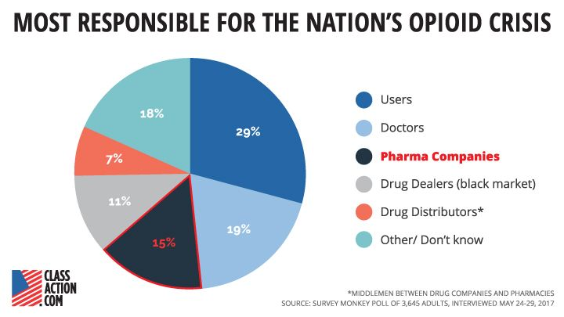

Slide 8
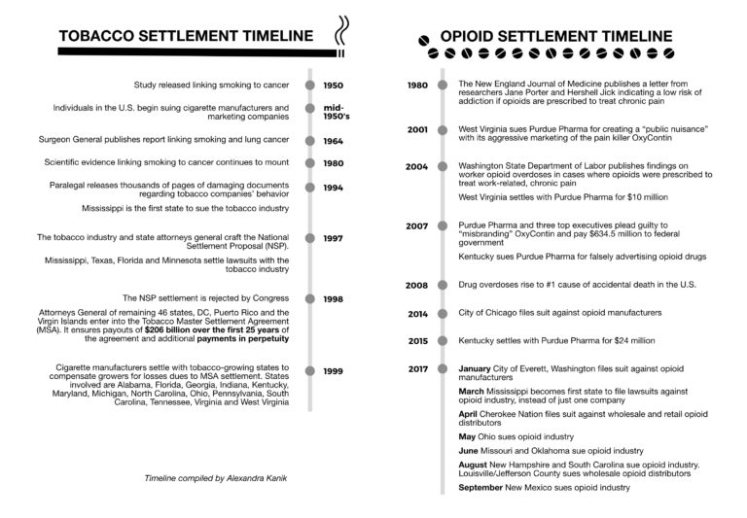

Slide 9
Timeline
2001
W Virgnia sues Purdue Pharma over Oxycontin marketing
2007-2008
Purdue settles class action lawsuit filed by 26 states, pleads guilty to federal criminal charges for illegally marketing
Cephalon pleads guilty to illegally marketing 3 drugs, including Actiq
2015-2018
Insys settles with Illinois over off-label marketing and improper payments to prescribers
Purdue settles lawsuits by NY and Kentucky over Oxycontin marketing
Mississippi AG sues Purdue, Cephalon, Teva, Janssen, Johnson and Johnson, Endo and Allergan
Additional states file suit.
41 states AG announce bipartisan investigation
At least 19 states and hundreds of local jurisdictions file suit

Slide 10
West Virginia v Purdue Pharma
Settled Nov, 2004
Allegations
-Aggressively marketed Oxycontin
-Concealed from prescribers the extent to which Oxycontin could lead to addiction
Settlement
-$10 million paid over 4 years to support drug and education programs, law enforcement initiatives

Slide 11
State of Oregon v Purdue Pharma
Settled May 2007
Allegations
-Unlawfully marketing Oxycontin for off-label use
-Misbranding Oxycontin as “less addictive, less subject to abuse and diversion, and less likely to cause tolerance and withdrawal than other pain medications”
Settlement
-$19.5 million
-Purdue pledged not to promote for off-label use
-Requires Purdue to maintain abuse and diversion detection programs, report problem prescribing, and specially train field personnel.

Slide 12
Off-Label Marketing and Misbranding
OxyContin, a time-released narcotic drug approved for the treatment of moderate to severe pain over an extended period of time. Purdue engaged in extensive off-label marketing of OxyContin and Purdue failed to adequately disclose abuse and diversion risks associated with the drug in violation of the Consumer Protection Act.
A complaint filed by the Consumer Protection Division alleges that Purdue aggressively promoted OxyContin to doctors and consumers as a first-choice analgesic for treatment of a wide variety of pain symptoms, including those beyond the approved indications and uses of the drug. Although OxyContin has addictive qualities similar to morphine, Purdue downplayed the known risks of OxyContin abuse, addiction and diversion for inappropriate uses. Purdue failed to adequately warn doctors or consumers of OxyContin’s significant risks and failed to take reasonable steps to guard against OxyContin abuse and diversion

Slide 13
Misbranding
Section 502 of the Federal Food, Drug and Cosmetic Act (FFDCA) contains provisions on misbranding including some that relate to false or misleading labeling. A device’s labeling misbrands the product if:
“It is dangerous to health when used in the dosage or manner or with the frequency or duration prescribed, recommended or suggested in the labeling”

Slide 14
Additional Settlements
Kentucky v Purdue: Medicaid Fraud ($24m)
California v Purdue: Deceptive marketing ($1.6m)
Illinois v Insys: Consumer Fraud ($4.5m)
USA v Purdue: Misbranding ($600m)
USA v Cardinal Health: CSA Violation ($44m)
USA v McKesson: CSA Violation ($150m)
USA V Mallinckrodt: CSA Violation ($35m)

Slide 15
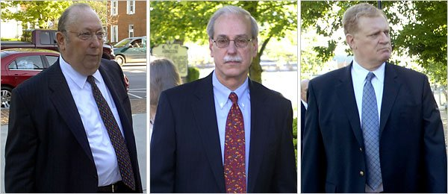
In Guilty Plea, OxyContin Maker to Pay $600 Million
Purdue Pharma acknowledged in the court proceeding today that “with the intent to defraud or mislead,” it marketed and promoted OxyContin as a drug that was less addictive, less subject to abuse and less likely to cause other narcotic side effects than other pain medications.
MAY 10, 2007
From left, Howard R. Udell, the top lawyer for Purdue Pharma; Dr. Paul D. Goldenheim, the company’s former medical director; and Michael Friedman, Purdue’s president.

Slide 16
Purdue Pharma Pleads Guilty
$635 million in criminal fines
Admitting to stating:
  Oxycontin did not cause a buzz of euphoria
  Oxycontin had less addictive potential
  Oxycontin had less abuse potential
  Oxycontin was less likely to be diverted
  Patients could stop Oxycontin therapy abruptly without experiencing withdrawal symptoms
  Patients taking Oxycontin would not develop tolerance to the drug

Slide 17
Current Status of Opioid Litigation
500+ lawsuits consolidated into multidistrict litigation (MDL) in federal district court for the Northern District of Ohio
Defendants include drug makers, distribution companies and companies that manage pharmacy benefits for most Americans.
US DOJ filed a statement of interest
Ongoing settlement discussions
-Purdue Pharma, Federal Judge Dan Polster

Slide 18
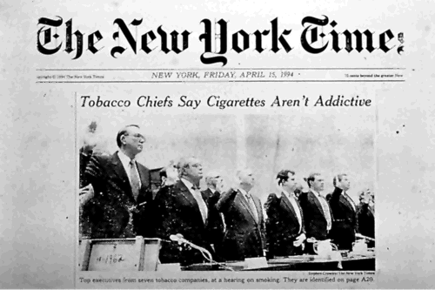
In November 1998, the Attorneys General of 46 states, five U.S. territories, and the District of Columbia reached a $246 billion settlement with the five largest American tobacco companies.

Slide 19
Master Settlement Agreement
The Master Settlement Agreement (MSA) is an accord reached in November 1998 between the state Attorneys General of 46 states, five U.S. territories, the District of Columbia and the five largest cigarette manufacturers in America concerning the advertising, marketing and promotion of cigarettes. In addition to requiring the tobacco industry to pay the settling states billions of dollars annually forever, the MSA also imposed restrictions on the sale and marketing of cigarettes by participating cigarette manufacturers.

Slide 20
Defendants
Four tobacco companies that accounted for nearly all cigarette sales in US
  Philip Morris
  RJ Reynolds
  Brown and Williamson
  Lorilland

Slide 21
Early Lawsuits Against the Tobacco Industry
1950s: Individual smoker suits
-Companies negligent in failing to disclose harmful nature of tobacco products
-Argue for strict liability for marketing a dangerous product
1954 – 1994: Over 800 cases files, none successful. Manufacturers, raising defenses such as contributory negligence and the individual responsibility of smokers, generally prevailed in these lawsuits.

Slide 22
Federal Compromise 1965
The first federal health legislation addressing tobacco was the Federal Cigarette Labeling and Advertising Act, passed in 1965.
Passed in the wake of growing public concern triggered by the original 1964 Surgeon General's report that concluded that smoking caused lung cancer (in men).
“ Warning: The Surgeon General has determined that cigarette smoking is dangerous to your health” ….. Surgeon General via Cigarette Labeling and Advertising Act of 1965

Slide 23
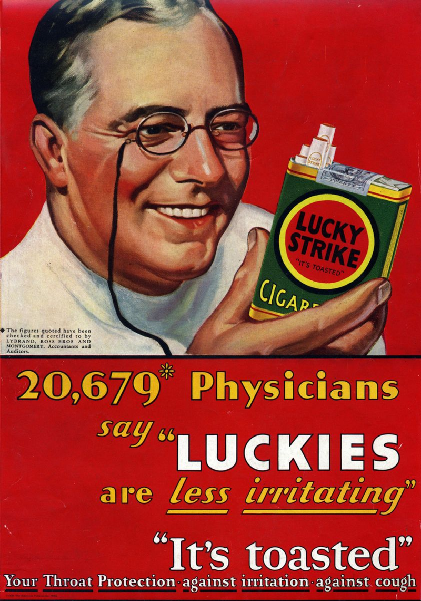
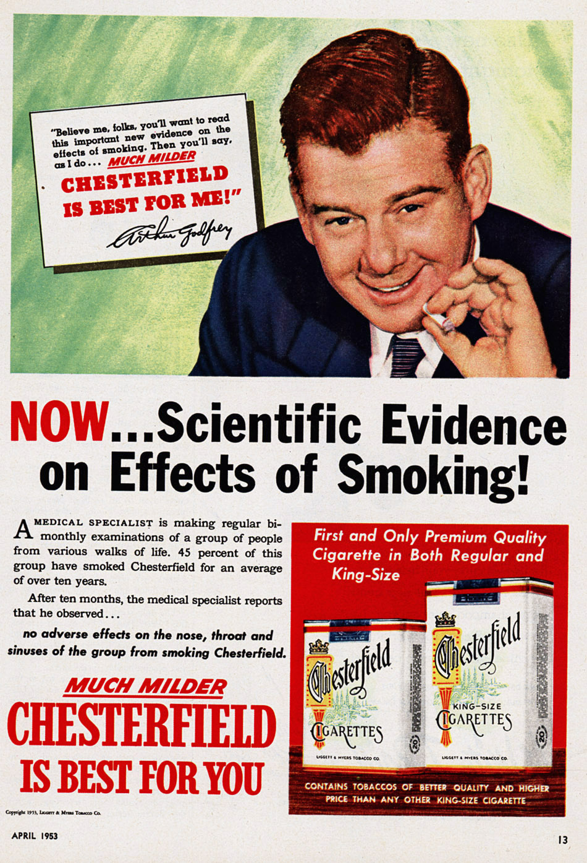
“Scientific Evidence”

Slide 24
Federal Compromise 1965
The price of the law was federal pre-emption of any controls on cigarette advertising including at the state or local level. The result was to choke off all subsequent local efforts that had anything to do with cigarette advertising.
The warning labels also provided the tobacco companies an important defense in court to fight liability for the disease and death that their products cause. At the time the FDA bill passed—44 years later—the US still had the weakest, least effective warning labels in the world. Indeed, one of the arguments for the FDA bill was that it required graphical warning labels and repealed this pre-emption

Slide 25
Federal Compromise 1970
The next compromise came in 1970, when health advocates worked with tobacco companies to remove cigarette advertising from television and radio. This compromise, too, turned out to be a strategic error because once the pro-tobacco advertisements were gone, the Federal Communications Commission “Fairness Doctrine” that had required free anti-smoking messages to counter the tobacco advertisements no longer applied. These anti-smoking advertisements were having a more profound effect on consumers than the cigarette advertisements and the industry wanted them gone. The tobacco companies simply shifted their marketing to other venues and public health messages disappeared from the airwaves.

Slide 26

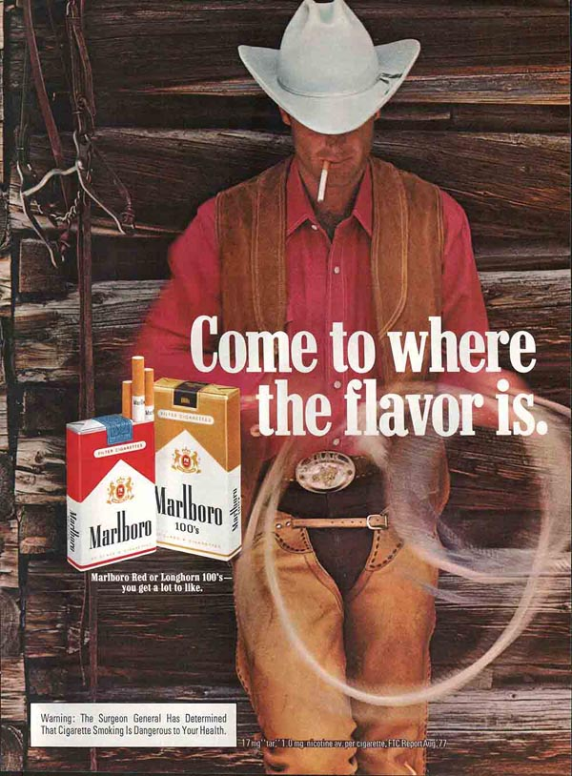
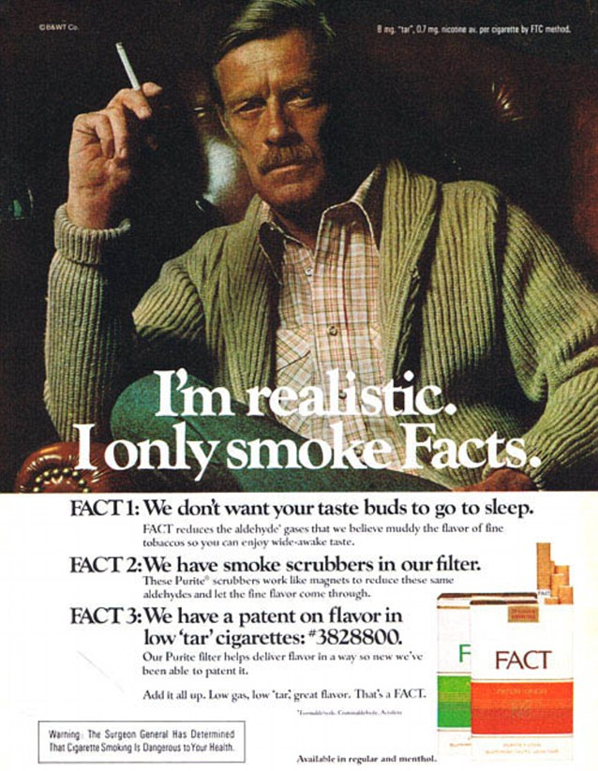

LLL
“Lifestyle”

Slide 27
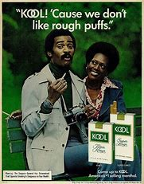

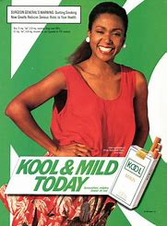
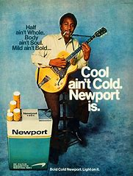
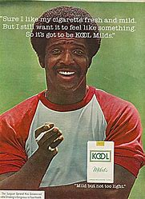
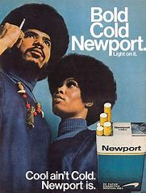
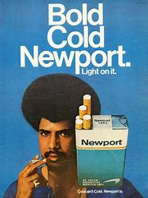


“Targeted Marketing”

Slide 28
Later Wave of Litigation
Focus on industry misconduct
1990s: Several cases with settlements
Cipollone v Liggett Group, Inc (1992)
-Federal warnings preempt most litigation
-Federal law does not prohibit lawsuits based on tobacco industry efforts to mislead
-Internal documents become publicly available
May 1994: Mississippi AG files first state lawsuit:
  Industry efforts to mislead public
  Liable for health costs incurred by state
  Similar lawsuits filed by Minnesota, W Virginia, Florida, Massachusetts
  48 states by 1998

Slide 29
New Strategy
In 1994, a number of states, beginning with Mississippi, sued the largest cigarette manufacturers under a variety of legal theories, including state consumer protection and antitrust laws, arguing that cigarettes contributed to health problems that triggered significant costs to state health-care systems

Slide 30
1997 (Pre) MSA
Four states (Mississippi, Minnesota Florida, and Texas), reached settlements to recover for Medicaid and other health expenses resulting from smoking-caused illnesses.
After these settlements, the major manufacturers, facing a growing number of suits by other states, joined with those states and petitioned Congress for a global resolution in June 1997.
Congress failed to pass the global settlement agreement, but the manufacturers and the Settling States were still able to reach a settlement in November of the following year: the Master Settlement Agreement.

Slide 31
MSA
First section of the MSA, the parties settled
-to avoid the further expense, delay, inconvenience, burden and uncertainty of continued litigation (including appeals from any verdicts).”
-to further the Settling States’ policies designed to: 1. reduce youth smoking
2. promote public health
3. secure monetary payment to the settling states
The MSA only settles state and local government lawsuits; the tobacco industry gains no protection from class-action lawsuits and claims brought by individuals, labor unions, and private health-care insurers.

Slide 32
MSA Payment Details
Just as the Settling States’ Medicaid and other health-care costs due to their citizens’ smoking-related illnesses will likely continue indefinitely, the MSA provides that the Participating Manufacturers’ payments to the Settling States will continue in perpetuity.
The “base amounts” of these annual payments gradually increase, beginning at $4.5 billion in 2000, $6.5 billion from 2002–2003, $8.14 billion from 2008–2017, and $9 billion in 2018 and each subsequent year in perpetuity.
Importantly, calculations of annual payments are complex and are subject to a variety of potential adjustments and offsets, including an inflation adjustment and a volume adjustment.
Most significantly, percentage reductions in cigarette shipment volumes have been greater than inflation adjustments since 1997, so actual annual payments have been lower than those set forth as base amounts in the MSA and can be expected to continue to be.
Participating Manufacturers are required to make annual payments based on their shares of national cigarette sales and shipments.

Slide 33
MSA imposed significant prohibitions and restrictions on tobacco advertising, marketing and promotional programs or activities:
Direct and indirect targeting of youth
Use of cartoon characters
Billboards, transit ads, and other outdoor advertising not in direct proximity to a retail establishment that sells tobacco products
Product placements in entertainment media
Free tobacco product samples (except in adult-only facilities)
Gifts to youth in exchange for proofs of purchase
Branded merchandise
Brand name sponsorships

Slide 34
MSA prohibits certain practices that seek to hide negative information about smoking
Lobbying against particular kinds of tobacco control legislation and administrative rules
Agreements to suppress health-related research
Material misrepresentations about health consequences of using tobacco
It requires the Participating Manufacturers to make available online the nonprivileged documents they disclosed during the discovery phase of the tobacco litigation

Slide 35
MSA created a tobacco prevention foundation and disbanded tobacco-industry initiatives
The MSA created the American Legacy Foundation, a research and educational organization that focuses its efforts on preventing teen smoking and encouraging smokers to quit. (The Truth Initiative)
The MSA dismantled key tobacco industry initiatives, including The Center for Indoor Air Research, The Tobacco Institute, and The Council for Tobacco Research.
In addition to disbanding these specific centers, the MSA prohibits Participating Manufacturers from creating other industry-wide groups unless such groups agree to act consistently with the MSA’s provisions.

Slide 36
MSA Money
While the MSA states that its primary purpose is to decrease youth smoking and promote public health, it does not contain any provisions requiring states to allocate settlement revenues to tobacco prevention and cessation.
As a result of decisions by state legislatures, which are responsible for deciding how the money is spent, state coffers lined with this money, coupled with billions in tobacco taxes and other substantial funds from tobacco companies, have not been used for tobacco control and prevention programs.
In 2015, states will receive $25.6 billion in revenue from the MSA settlement and tobacco taxes, but only 1.9% of these funds have been earmarked for tobacco control programs.

Slide 37
Securitization
The MSA does not limit the purposes for which the Settling States may use their funds. Some state and local governments have securitized their future MSA payments to generate short-term cash to cover budget shortfalls.
Many state and local governments’ tobacco bond ratings have been downgraded in recent years, reflecting the difficulty they now face in meeting interest and maturity requirements.
The downgrade was the result of several factors, including downward MSA payment adjustments based on the declining volume of cigarette sales by Participating Manufacturers, unanticipated by the financial industry. The declining sales were caused in turn by declining cigarette consumption, the increased sale of products by cigarette manufacturers not signatories to the MSA, and tax increases.

Slide 38
MSA Shortcomings
Settlement payments were based on tobacco company sales rather than as a lump sum obligation, which would have been borne by shareholders, the payment schedule was structured like a per unit excise tax imposed on a commodity.
Conceptually, such a tax is shifted to consumers of the product, and when the market structure is oligopolistic, as is the tobacco industry, there may be an over shifting of the tax. Imposition of an excise tax-like payment may facilitate collusion in price among competing companies.
Thus, profitability may increase after the tax is imposed. In the month following passage of the MSA alone, tobacco retail prices rose by 18.8% per pack

Slide 39
Tobacco Industry Response
The penalty for 1999 amounted to $0.40 per pack, including the cost of the four individual state settlements that were no part of the MSA. But price per pack rose by $0.73 between 1998 and 1999, a 29.7% increase for the year, most of which occurred in the month immediately following the MSA.
There was an increase of $0.64 in the per pack price of cigarettes in the USA.
Although overall domestic consumption of cigarettes decreased, the cigarette price increases more than offset such declines.
As a result, the companies remained profitable

Slide 40
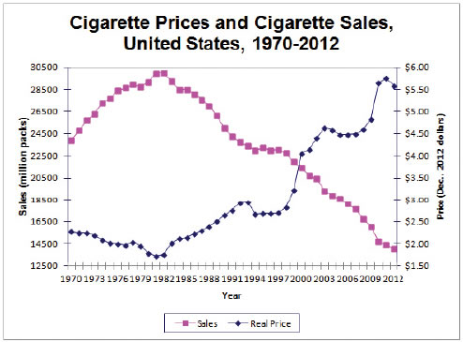

Slide 41
As part of the agreement enshrined in the MSA, Participating Manufacturers will have paid states about $106 billion in settlement funds through 2015, 59 and will pay billions more in perpetuity.
PA 2017/2018 Budget: $362.3 million (“as in previous years, the General Assembly amended the Fiscal Code’s funding provisions to redirect tobacco revenue to help fund Medical Assistance long-term care in the Dept. of Human Services”)
Line item expenditures: Tobacco Use Prevention and Cessation: $15,822
-Tobacco Settlement Fund Budget Briefing, Jan 12, 2018

Slide 42
On June 12, 2009, the United States Congress passed the Family Smoking Prevention and Tobacco Control Act (S. 982), granting the US Food and Drug Administration (FDA) authority regulating tobacco products.
Grants the FDA general authority over tobacco products, including the ability to reduce (but not eliminate) nicotine
( A 1995 initiative to classify cigarettes as drugs (nicotine delivery devices) would give FDA jurisdiction over cigarette manufacturing, seen as a “Threat to industry”
Requires improved warning labels on cigarette and other tobacco packages
Implements the rules limiting marketing of tobacco products to youth that the FDA issued in 1996.
It also repeals pre-emption of state and local regulation of tobacco marketing and advertising, and grants states and localities broad rights to regulate or prohibit the sale, distribution, possession, exposure to, access to, or use of tobacco products.
Center for Tobacco Products formed

Slide 43
The New FDA Law 2009
Evidence in millions of pages of tobacco industry documents now publicly available demonstrates that Philip Morris has been planning for FDA legislation for well over a decade and illustrates how such regulation fits into its business plan
In 1998, a Philip Morris legal white paper, “Design, Manufacturing and Marketing of Tobacco Products: Towards a Sensible Regulatory Framework,”

Slide 44
Philip Morris
“Reasonable” FDA authority “would continue to permit adults to assume the inherent risks of smoking, while allocating to the government the twin tasks of ensuring that manufacturers don't create additional risk through their design and manufacturing processes, on the one hand, and continuing to conduct appropriate research about the nature of the inherent risks and keeping consumers informed of them on the other”.
Like warning labels, this white paper appears to suggest that Philip Morris anticipated the legislation would help shift liability from cigarette companies for the dangers of smoking and place responsibility for informing consumers of the risk upon the government.

Slide 45
FDA 2017
Reduce tobacco related death and disease
“Nicotine and addiction”
Ensure scientific and regulatory foundation
Encourage development of innovative, less dangerous products

Slide 46
MSA Legal Analysis
Equitable Claims/Consumer Protection Claims
Consumer Fraud
Public Nuisance
Restitution
Unjust Enrichment

Slide 47
Venue
State courts over federal courts
“Industry friendly federal government”
States are not “citizens”, therefore cases could not be removed to federal court

Slide 48
Damages
Lung cancer, heart disease, high levels of morbidity already established.
Quantification needed ($$$$)
Univ of California developed statistical model that reliably determined the “tobacco-attributable fraction” of overall health care costs.

Slide 49
“Smoking Guns”
Internal leaks of industry documents
“Tobacco was in the business of selling nicotine, an addictive substance useful in the treatment of stress mechanisms”
Lacing of cigarettes with ammonia and other chemicals to boost bioavailability of nicotine

Slide 50
“Seven Pillars of Fraud”
Denied harmful effects of smoking and passive smoking.
Promoted “independent” research
Denied smoking was addictive
Denied manipulation of nicotine levels
Promoted light and low tar products as less harmful
Marketed to youth
Concealed and suppressed evidence

Slide 51
Other Factors
Prestige of Mississippi Attorney General Mike Moore
Mainstream Media
-Favored Plaintiffs > Tobacco defendants
Political affiliations and co-counsel
Personal relationships with AG Moore
President Bill Clinton
FDA Commissioner Dick Morris
Senate Majority Leader Trent Lott

Slide 52
Impacts of the Master Settlement Agreement on the tobacco industry
Main outcome measures: Stockholder returns, operating performance of defendant companies, exports, market share of the original participants in the MSA, and advertising/promotion expenditures.
Conclusion: The experience during the post-MSA period demonstrates that the MSA did no major harm to the companies. Some features of the MSA appear to have increased company value and profitability

Slide 53
MSA
$206 Billion over 25 years
Additional payments in perpetuity based on annual volume of cigarette sales
Funds for national foundation
Public release of additional internal documents
Disband industry research entities and front groups
Does not affect lawsuits brought by other entities

Slide 54
MSA in Retrospect
Truth Initiative
Tobacco Industry Documents
Cigarette price increases
Some investment in public health
Diverted funding
Questionable impact on smoking rates

Slide 55
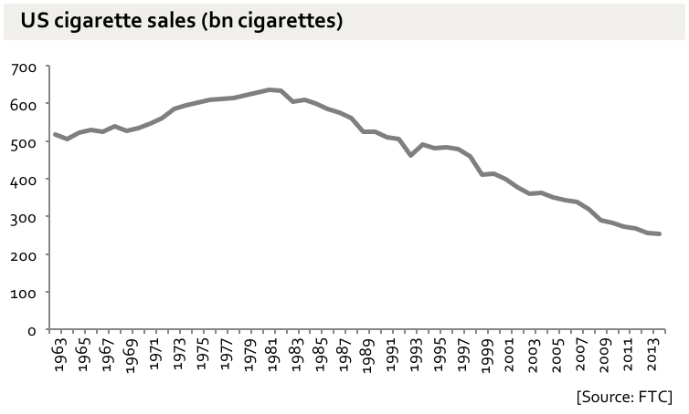
Teen cigarette use today stands at 6%, down from 23% in 2000
-Truth Initiative

Slide 56
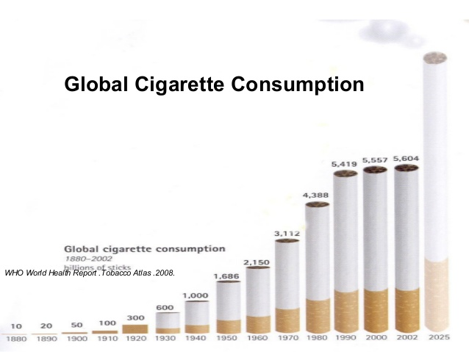

Slide 57
Opioid Litigation
Principal plaintiffs are governmental entities
-Seven states
-Thirteen counties
-Five cities
-One Indian Nation
Profusion of county and municipal plaintiffs differs from Tobacco litigation

Slide 58
Multiplicity of Plaintiffs and Defendants
Unified control of legal teams is difficult
There are at least 20 opioid manufacturers and 13 distributors sued to date (compared with 5 tobacco company defendants)

Slide 59
Purdue Pharma, Teva Pharmaceuticals, Johnson & Johnson, Janssen Pharmaceuticals, Endo Health Solutions, Allergan PLC, and Actavis, Inc. are among the drug companies named as defendants in opioid litigation.
The allegations made against drug companies are virtually identical. A State of Ohio lawsuit, for example, makes the typical assertions that manufacturers
Engaged in a deceptive marketing scheme designed to change opioid prescribing patterns (from end-of-life care only to “chronic pain”). This greatly broadened the pool of patients to whom opioids could be prescribed and led to a huge increase in profits for opioid manufacturers.
Downplayed the addiction risks and overstated the benefits of opioid painkillers.
Worked through third parties—including front groups and key opinion leaders—to disseminate their misleading messages about opioids.
Placed their desire for profits above the health and well-being of their customers and the communities where they live, and in so doing unleashed a public healthcare crisis with extensive financial and social consequences.
Caused substantial economic injury to state, city, and county agencies

Slide 60
The major distributors of opioid painkillers are AmerisourceBergen, Cardinal Health, and McKesson Corporation. Because drugs like oxycodone and hydrocodone are controlled substances, licensing regulations impose duties on distributors to provide effective controls and procedures to prevent theft and diversion of opioids.
Lawsuits, including a case filed by New Mexico, claim that these distributors played a crucial role in perpetuating the opioid crisis because they violated these duties and allowed opioid diversion to flourish.
New Mexico accuses drug distributors of the following:
Selling huge quantities of prescription opioids that were diverted from lawful medical purposes
Breaching their legal duties to prevent diversion
Failing to report suspicious opioid orders (orders of unusual size, orders of unusual frequency, and orders deviating substantially from a normal pattern)
Failing to monitor, detect, halt, investigate, and refuse suspicious orders
Misleading the public about complying with their obligations to meet licensing regulations
Causing substantial economic damages to state and local governments due to their breaches of legal duties

Slide 61
Claims
Consumer protection statutes
Equitable principles
  Public nuisance
  Restitution
  Unjust enrichment

Slide 62
“Non tort based claims”
Do not hinge on fault
Based on who should pay when public is damaged by conduct of a legal business
“Non-fault based equity claims”
-Defendant claims FDA regulation preempts
-Addiction warning labels were
“ipso facto” sufficient

Slide 63
Diversion Theory
Unique to opioid litigation, diversion claims charge that manufacturers did not secure distribution chain

Slide 64
Defenses Preemption
FDA approval
Warnings and labels accompanying sale
Opioid manufacturers challenge causation between opioids and drug abuse
Causation is an issue in need of statistical methods, such as in tobacco litigation

Slide 65
Legal
States have retained many key lawyers from Tobacco Litigation
State attorneys general, private law firms
Opioid manufacturers have also retained experienced lawyers from Tobacco litigation

Slide 66
Damages
Difficult to calculate damages
Health care costs/law enforcement costs complex
Other drugs of abuse
Statistical method to derive an “opioid attributable fraction of medical and law enforcement costs is not apparent
Must prove damages

Slide 67
Media
“Big Pharma” not an appealing defendant
Overdose deaths issue
Previous Fines
Numerous federal and state settlements
“De Facto presumption of liability”

Slide 68
Strategy
Plaintiffs
Coordination (unified strategy)
Methodology for estimating cost to public
Defendants
Coordination (unified strategy)
Realizing that claims are non-tort based equity claims (warnings and risk assumption are legally insufficient)

Slide 69
Federal Government
The federal government's decision to join lawsuits against opioid manufacturers and distributors is a "game changer," said Ohio Attorney General Mike DeWine.
DeWine, along with attorneys general from several other states, attended a press event where U.S. Attorney General Jeff Sessions said a new federal task force not only will seek civil and criminal charges against manufacturers, but also would “examine existing state and local government lawsuits against opioid manufacturers to determine where we can be of assistance.”

Slide 70
Federal Government
The Food and Drug Administration is planning new rules for drug wholesalers later this summer, while the Drug Enforcement Administration is working on its own regulation for dealing with suspicious drug orders.

Slide 71
“Regulation by Litigation”
Any settlement will likely follow the template of the tobacco Master Settlement Agreement, a quarter of a trillion-dollar wealth transfer that bloated state governments, levied unlegislated and cruelly regressive taxes on smokers, and sent $20 billion in unappropriated public money to the state AGs’ favorite donors: the mass-tort trial lawyers who have become government-financed Lawyer Barons.
A similar settlement on opioids would temporarily ease fiscal crises in the many states that have frittered away their tobacco-settlement money; but it would only encourage more such lawless and unlegislated regulation of other targets. Furthermore, it will lead to higher pharmaceutical prices and higher healthcare costs and premiums, in a process that is utterly opaque to the public, taxed without representation to enrich the lawyer

Slide 72
Kentucky AG and Endo Pharma
Seeks compensation on behalf of the Commonwealth for increased costs to the state. These include costs from emergency room visits, emergency responses to overdoses, the administration of anti-overdose drug Naloxone, Hepatitis C from intravenous opioid use, drug-related crimes, and other harms.
Kentucky claims these damages are the result of Endo’s allegedly deceptive, aggressive, and illegal opioid marketing.
“This action seeks repayment of the Commonwealth’s spending on opioids, disgorgement of Endo’s unjust profits, civil penalties for its egregious violations of law, compensatory and punitive damages, injunctive relief, and abatement of the public nuisance Endo has helped create.”

Slide 73
First Wave of Opioid Litigation
Focused on individual manufacturers
Settled for relatively small sums
Purdue
- settled with W Va for $10 million
-26 states class action settlement: $19.5 million
Insys
-settled with Illinois for $4.5 million
-settled with Mass for $500,000

Slide 74
Second Wave of Opioid Litigation
Collective accountability
Coordinated investigation
Seeking more significant monetary concessions

Slide 75
Legal Claims
Medicaid Fraud
Unfair and Deceptive Trade Practices
Negligent Misrepresentation
Public Nuisance
Unjust Enrichment
Racketeering

Slide 76
Legal Claims
Government agencies are seeking reimbursement for some of the health and social costs related to opioid abuse, which is estimated to be in excess of $55 billion each year.
Some of the specific damages being sought include:
Building and maintaining treatment facilities.
Reimbursement of Medicaid and other governmental expenses related to the treatment of addicts, including the payment for unnecessarily prescribed opioids, and the antidote to treat overdoses.
Reimbursement for added law enforcement and medical personnel to treat the opioid epidemic.
Reimbursement for costs of prosecutions and jails.

Slide 77
Alleged Misconduct
Paid front groups to make activities appear independent
Avoided regulatory restrictions through unbranded marketing
Promoted scientifically suspect research, medical education, and treatment guidelines
Promoted increased prescribing while misrepresenting risks/benefits
Targeted certain practitioners to increase volume

Slide 78
Advocacy Funding
2012 – 2017: Financial contributions to Senate staff exceeded $10 million, supporting 14 advocacy groups
  Academy of Integrative Pain Management
  US Pain Foundation
  American Academy of Pain Medicine
  American Chronic Pain Association
  American Geriatrics Society

Slide 79
Federal Regulatory Landscape
Tobacco
Required health warnings on cigarette packaging
Prohibited advertising on radio and television
Prohibited smoking on domestic flights
Opioids
Food Drug and Cosmetic act
Controlled Substance Act
Primary Jurisdiction

Slide 80
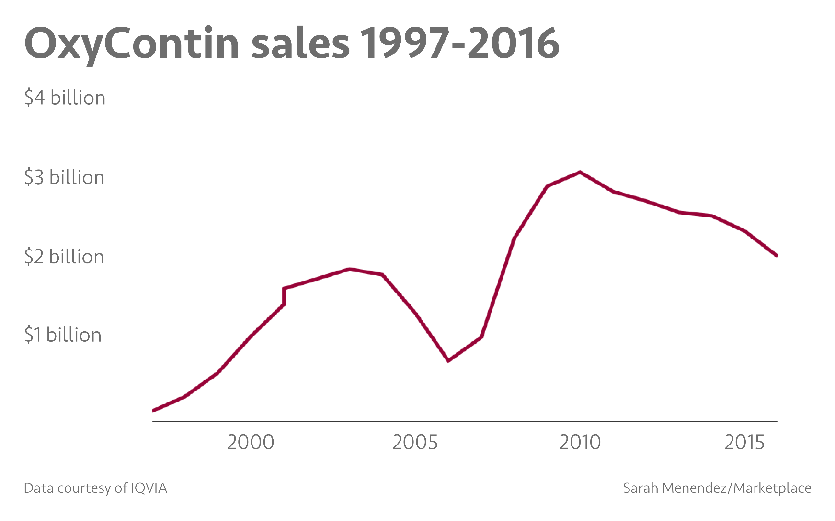

Slide 81
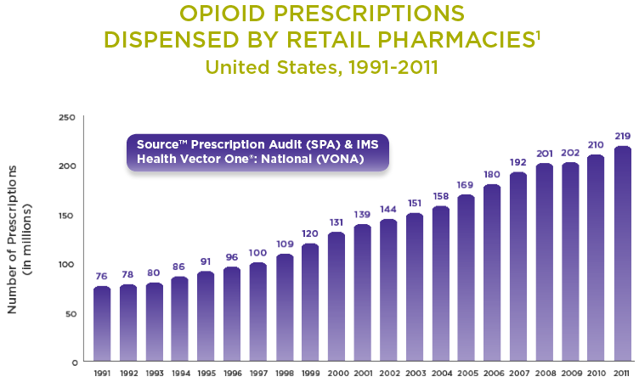

Slide 82
US Opioid Rx 2013-2015
IMS Health, an information firm whose data on prescribing is used throughout the health care industry, found a 12 percent decline in opioid prescriptions nationally since a peak in 2012. Another data company, Symphony Health Solutions, reported a drop of about 18 percent during those years

Slide 83
Opioid Epidemic
What is being done?
-Public health, criminal justice responses, treatment and medical industry responses
Where does litigation fit in?

Slide 84
Multidistrict Litigation (MDL)
Consolidation of 66 federal lawsuits spanning 11 federal districts and 9 states into one MDL called the “National Prescription Opiate Litigation”
US District Judge Dan Polster, Northern District of Ohio

Slide 85
Litigation Goals
$$$$$$$
-OUD costs can be in tens to hundreds of billion dollars annually
-Entire US opioid market is about $10 billion
-Much less than value of tobacco industry
Harm Reduction? Public Health?

Slide 86
Reimbursement
Health/Social costs > $55 Billion/year
Build and maintain treatment facilities
Reimburse Medicaid/other gov't’ expenses
Reimburse law enforcement/medical personnel
Reimburse cost of prosecution

Slide 87
Litigation Goals
If goal is $$$$$:
-MAT, naloxone, syringe access, supervised consumption
OUD/OD Prevention:
-Child care
-Safe streets
-Life skills training
-Quality education
-Job training
-Decarceration

Slide 88
Projections
Andrew Kolodny, co-director of opioid policy research at Brandeis University, says at least $6 billion a year is needed for 10 years to set up a nationwide network of clinics and doctors to provide treatment with medicines like buprenorphine and methadone.
Recently proposed legislation modeled on the Ryan White Act that would appropriate $100 billion over 10 years for research, treatment and support.

Slide 89
References
Bad Acts, Eubanks, Glantz; Alpha Press, 2012
Tobacco Control Legal Consortium; Federal Regulation of Tobacco: A Summary, Jul, 2009
US Judicial Panel on MDL; MDL No. 2804, Dec 2017
Local Governments v Big Pharma; NCBA Blog, Nov 2017
Drug Companies Liability for Opioid Epidemic; NEJM; Dec 2017
US Senate Gov’t Affairs Committee

