Slide 1
Is EBP Really Improving Practice?
Dr. Martha Thompson

Slide 2
Objectives for the day
Discuss three pros and cons of Evidence Based Practices
Identify several challenges of privatized health care and treatment
Develop strategies and ideas to manage the changes we face with EBP and privatization

Slide 3
Trying to identify specific interventions that could be dispensed reliably for specific problems has a strong common-sense appeal. No one would argue with the success of the idea of problem-specific interventions in the field of medicine. But the evidence is incontrovertible.

Slide 4
Go to Kahoot.it on your phone or laptop

Slide 5
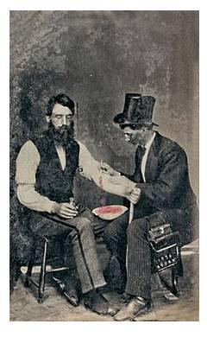
A brief history of EBP
The roots of evidence-based practice are in evidence-based medicine. The history of evidence-based medicine has been well documented and includes primitive experiments to test the effectiveness of practices such as bloodletting (Claridge and Fabian, 2005).
Early image of bloodletting

Slide 6
History continued
1972 - Archie Cochrane pointed out the importance of properly testing the effectiveness of health care strategies, and stressed the role of randomized controlled studies to provide evidence on which health care is based.
The term "evidence-based medicine" was introduced by Guyatt et al in 1992 to shift the emphasis in clinical decision making from "intuition, unsystematic clinical experience, and pathophysiologic rationale" to scientific, clinically relevant research.

Slide 7
A bit more history
1996 - Sackett et al explained evidence-based clinical decision making as a combination of not only research evidence but also clinical expertise, taking into account the patient’s preferences.
Clinical expertise was defined as the “proficiency and judgment that individual clinicians acquire through clinical experience and clinical practice”.

Slide 8
Hang on the history lesson is almost over
2003 - a statement on evidence-based practice was prepared by the delegates of the Evidence-based Health Care Teachers and Developers conference.
The conference was held in Sicily, and the statement is known as the Sicily Statement (Dawes et al, 2005).
It helped to introduce the broader concept of evidence-based decision making to health care generally.

Slide 9
2009 - Satterfield et al developed a transdisciplinary model for evidence-based practice.
This model depicts the three core components of EBP (best available research evidence, clinical expertise and patient’s preferences) within the broader clinical or organizational context.
In a sense, the organizational context is a fourth EBP component.

Slide 10
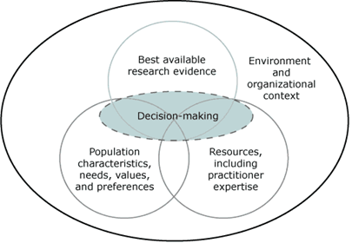
Satterfield et al (2009) Toward a Transdisciplinary Model of Evidence-based Practice. Millbank Quarterly 87(2): 368-390.

Slide 11
How are we doing now
The formalized concept was embraced by many, but also elicited some criticisms, including that evidence-based medicine relies too heavily on research.
It was still being described by some as a “new approach” almost twenty years later (Selvaraj et al, 2010), suggesting that it has taken some time to become integrated into the medical profession worldwide.
It’s 2017…..where are we now?

Slide 12
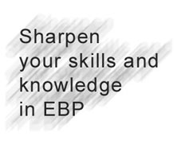
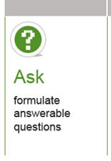
EBP (does this help us do better therapy)

Slide 13
Ask: Formulate a question that encompasses the clinical scenario, and for which evidence can be found by searching the literature. To facilitate the search process, the question should include terms that can be used in the literature search.
Acquire: Search the peer-reviewed literature for research evidence relevant to the clinical question.
Appraise: Evaluate the relevant research evidence, to find the highest quality (most reliable, or valid) evidence available relevant to this question.

Slide 14
Apply: Use the highest quality research evidence in combination with clinical expertise and the patient’s preferences, within the context of the practice environment, to make a clinical decision (e.g. a strategy for treatment, diagnosis or management).
Audit: A regular assessment of the extent to which clinical decisions in the practice were based on the best available research evidence.
How do you apply these steps?
Where is there room for improvement?

Slide 15
EBP for DA treatment
Behavior therapy and CBT
Modest to strong research support
Mindfulness based cognitive therapy
Strong research support
Acceptance and commitment therapy
Modest to strong research support
Dialectical behavioral therapy
Strong research support
Motivational Interviewing
Strong research support

Slide 16
What we are looking for with EBP
Diagnosis how to select and interpret diagnostic tests
prospective, blind comparison to a gold standard or cross-sectional
Therapy how to select treatments that do more good than harm and that are worth the efforts and costs of using them
randomized controlled trial > cohort study
Prognosis how to estimate the patient’s likely clinical course over time (based on factors other than the intervention) and anticipate likely complications of disease
cohort study > case control > case series
Harm/Etiology how to identify causes for disease (including iatrogenic forms)
cohort > case control > case series

Slide 17
Meta-analysis will thoroughly examine a number of valid studies on a topic and mathematically combine the results using accepted statistical methodology to report the results as if it were one large study

Slide 18
When EBP becomes mandated…
The purpose of EBPP is to promote effective psychological practice and enhance public health by applying empirically supported principles of psychological assessment, case formulation, therapeutic relationship, and intervention. – APA 2005
Is it really effective?
Little is known about the effectiveness of services offered by the community sector (Figure 3; Dillenburger, 2001; Smyth, 2001), mainly because of problems with agreement on evaluation methods, content to be evaluated, outcome measures, theoretical perspectives, heterogeneity of type of interventions, and complex political contexts (Forte, Hill, Pazder, & Feudtner, 2004; Lavoie, 1990).

Slide 19
What makes us effective?
Supershrinks
Clients of the best therapists improve at a rate at least 50 percent higher and drop out at a rate at least 50 percent lower than those of average clinicians
Who provides the therapy is a much more important determinant of success than what treatment approach is provided.

Slide 20
Bruce Wampold and Jeb Brown in 2006 published in the Journal of Consulting and Clinical Psychology. 581 licensed providers, including psychologists, psychiatrists, and master's-level providers, who were treating a diverse sample of over 6,000 clients.
The therapists, the clientele, and the presenting complaints were not different in any meaningful way from clinical settings nationwide.
The clients' age, gender, and diagnosis had no impact on the treatment success rate and neither did the experience, training, or theoretical orientation of the therapists.
Notes:
However, clients of the best therapists in the sample improved at a rate at least 50 percent higher and dropped out at a rate at least 50 percent lower than those assigned to the average clinicians in the sample.

Slide 21
Making the best
The best of the best simply work harder at improving their performance than others.
To reach the top level, attentiveness to feedback is crucial.
It isn't the same as the number of hours spent on the job, but rather the amount of time devoted specifically to reaching for objectives "just beyond one's level of proficiency.“
https://www.psychotherapy.net/article/successful-psychotherapists

Slide 22
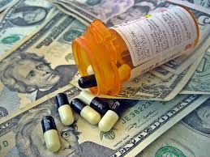
Show me the $$$$$$
Investors seek big bucks in DA treatment
“to work for a place that makes its
money feeding off the sick and
suffering like that must be hard.
I guess everybody has to make
a living though.”

Slide 23
Pros and Cons of Privatization
Mission statement
Non profit
Insurances taken
Daily costs
Services offered
Regulations
Waitlists
Mission statement
For profit
Insurances taken
Daily costs
Services offered
Regulations
Waitlists

Slide 24
Rouge Rehabs
Dr. Oz and Sarah Howe

Slide 25
Working in an imperfect system
Now what do we do….
We are mandated to use EBP
but we are not really using EBP
We want to be the best we can be
But are we able to do that
We want our clients to get quality treatment
But is that fair or really happening

Slide 26
The end ☺
Martha Thompson PsyD., LPC., CAADC
Empower the Mind LLC
drmartha@empowerthemind.org
717-304-2631

